Slide 1
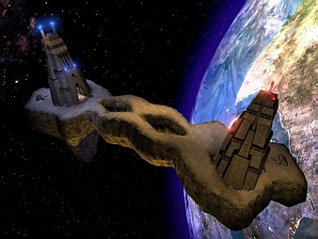
Pogamut 3
Faculty of mathematics and physics
Charles University in Prague
28th March 2013
UT2004 bots made easy!
Lecture 5 – Navigation

Slide 2
Warm Up!
Fill the short test for this lessons
5 minutes limit

Slide 3
Today’s menu
Navigating inside UT2004
Big Picture
PogamutUT2004 World Abstraction
PogamutUT2004 Navigation

Slide 4
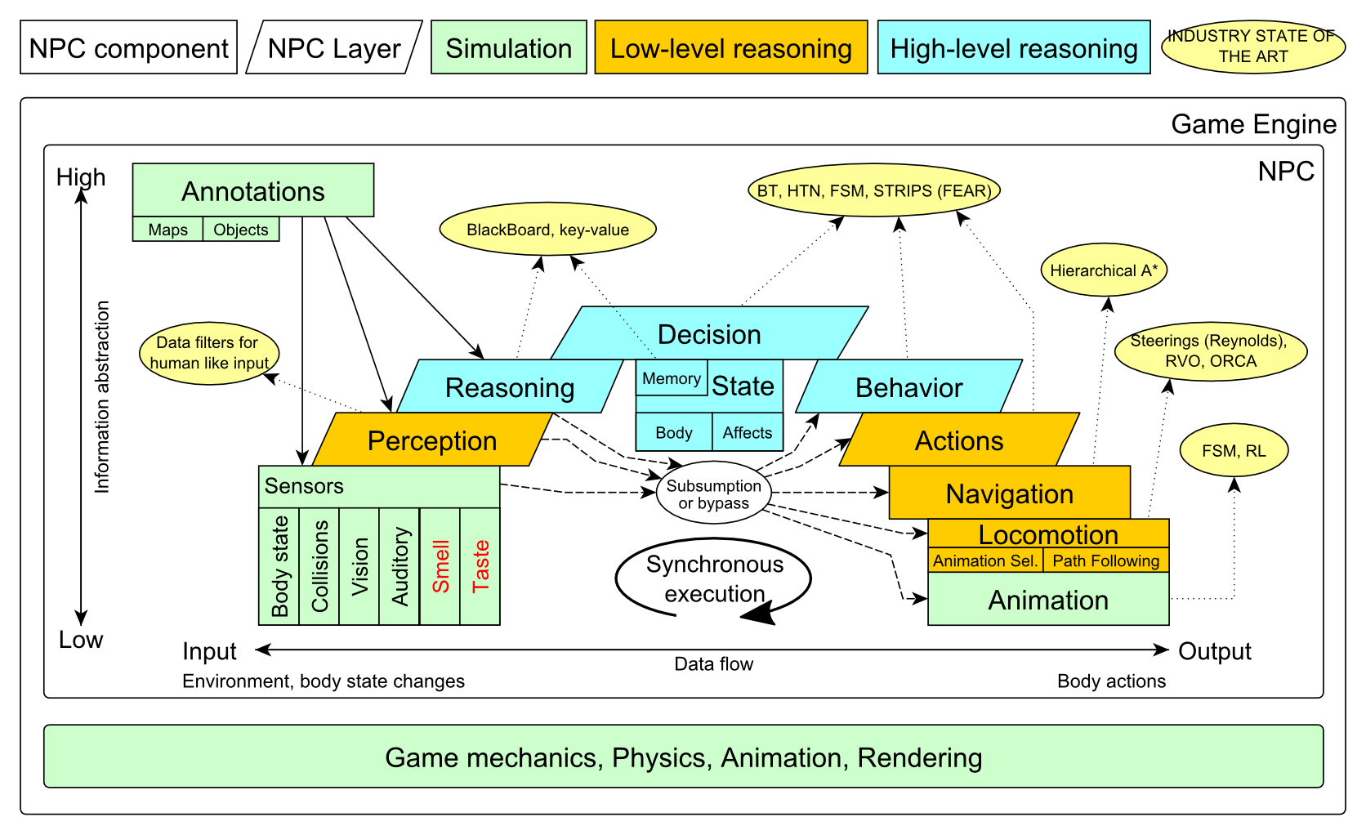
Big Picture Already covered

Slide 5
Big Picture Today

Slide 6
Today’s menu
Navigating inside UT2004
Big Picture
PogamutUT2004 World Abstraction
PogamutUT2004 Navigation

Slide 7
Pogamut World Abstraction Basics
Objects (IWorldObject):
Player
Item
NavPoint
Self
IncomingProjectile
Events (IWorldEvent):
HearNoise & HearPickup
BotDamaged & BotKilled
PlayerDamaged & PlayerKilled,
Bumped
GlobalChat
Use modules, listeners and Pogamut helper classes!
this.players, this.items, this.info …
MyCollections, DistanceUtils
if (this.players.canSeePlayers()) { … }
@EventListener(eventClass = GlobalChat.class)
public void chat(GlobalChat chatEvent) {
…
}

Slide 8
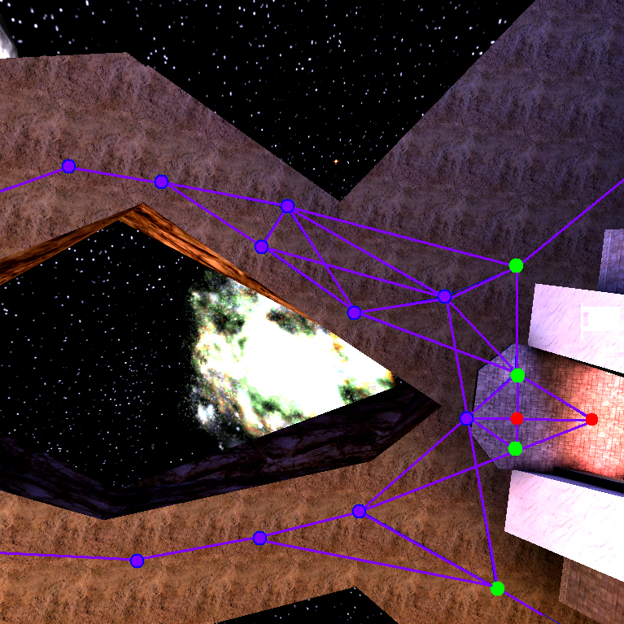
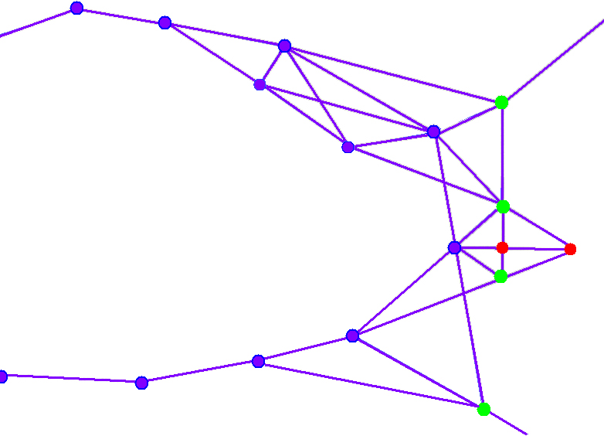
UT2004 World Abstraction Navigation graph
#Navpoints in the map = 100 – 5000

Slide 9
UT2004 World Abstraction Underlaying classes – low level API
Classes of interest:
NavPoint, NavPointNeighbourLink, Item
ILocated, Location, DistanceUtils
ItemType, ItemType.Category
ItemDescriptor
Methods of interest:
this.items.getAllItems(ItemType)
this.descriptors.getDescriptor(ItemType)
this.world.getAll(NavPoint.class)
this.world.getAll(Item.class)
NavPoint.getOutgoingEdges()
NavPoint.getIncomingEdges()
!!!

Slide 10
UT2004 World Abstraction NavPoint/NeighbourLink types
NavPoint types
JumpPad
Lift
Teleport
Door
PlayerStart
SnipingSpot
InventorySpot
…
Link flags
Walk
Jump
Lift
Door
DoubleJump
…

Slide 11
Today’s menu
Navigating inside UT2004
Big Picture
PogamutUT2004 World Abstraction
PogamutUT2004 Navigation

Slide 12
Navigation Step by step
Navigation steps:
Decide where to go
Plan the path (list of navpoints)
Follow the path
Handle jumps&lifts along the way!
Do you know right constants?
World is non-deterministic, be sure to check how the action is executing!
=> IStuckDetector implementations
Don’t worry it’s already wrapped up ☺

Slide 13
Navigation Step by step
Decide where to go (Decision making!)
items.getSpawnedItems(ItemType)
navPoints.getNavPoints()
DistanceUtils.getNearest(…)
MyCollections.getRandom(…)
fwMap.getNearest(…)
2. + 3. Plan and follow the path
UT2004Navigation (this.navigation)

Slide 14
Navigation UT2004Navigation
Complete navigation wrapper
UT2004Navigation(…, UT2004PathExecutor, FloydWarshallMap, …) (this.navigation)
Handles both path planning & path following
Can be called repeatedly
Contains this.pathExecutor, this.fwMap
Main methods
navigation.navigate(…)
navigation.isNavigating()
navigation.stopNavigation()
Uses
FloydWarshallMap (this.fwMap)
StuckDetectors
UT2004PathExecutor

Slide 15
Navigation FloydWarshallMap
Pogamut path planner uses Floyd Warshall algorithm (O(n³) !)
Used by UT2004Navigation
Access by this.fwMap
FW matrix is auto-initialized
Methods of interest
fwMap.getNearest…(…)
Works the same as in DistanceUtils, except the distance is measured by the path length
Its ok to “spam” it (e.g. checking all items in each step), the nowadays computers can handle it

Slide 16
Navigation Modifying the navigation graph
NavigationGraphBuilder
Access by this.navBuilder
Methods of interest
navBuilder.removeEdgesBetween(…)
If you use navBuilder in botInitalized method, everything will be applied automatically
Otherwise, call fwMap.refreshPathMatrix()
O(n³) !!

Slide 17
Navigation StuckDetectors
Navigation Uses 3 stuck detectors
UT2004TimeStuckDetector(bot, 3000)
if the bot does not move for 3 seconds consider it is stuck (check small velocity delta)
UT2004PositionStuckDetector()
watch over the position history of the bot, if the bot does not move sufficiently enough, consider that it is stuck
DEFAULT_HISTORY_LENGTH, DEFAULT_MIN_DIAMETER, DEFAULT_MIN_Z
UT2004DistanceStuckDetector()
counts how many times the bot was getting closer to the target and how many times it was getting farther (if it oscillates more than two times -> STUCK)

Slide 18
Navigation Listening for navigation events
With a FlagListener! Add one with method addStrongNavigationListener
this.navigation.addStrongNavigationListener(
new FlagListener<NavigationState>() {
@Override
public void flagChanged(NavigationState changedValue){
switch (changedValue) {
case STUCK:
break;
case STOPPED:
break;
case TARGET_REACHED:
break;
case PATH_COMPUTATION_FAILED:
break;
case NAVIGATING:
break;
}
}
});

Slide 19
Navigation Path following hell
UT2004PathExecutor
Custom Pogamut path following code
Heavily tweaked for UT2004 and game update frequency 4 Hz (250 ms per synchronous batch)
The good
Works decently on non-complex maps
You don’t have to do it yourself
The bad
Has problems handling complex links
Spaghetti code

Slide 20
Navigation Stuck detection details
Inside UT2004PathExecutorStuckState
Who has detected the stuck
Which NavPointNeighboutLink bot failed to traverse
Version: 3.5.1-SNAPSHOT and later
this.pathExecutor.getState().addStrongListener(
new FlagListener<IPathExecutorState>() {
@Override
public void flagChanged(IPathExecutorState event) {
switch (changedValue.getState()) {
case STUCK:
UT2004PathExecutorStuckState stuckDetails =
(UT2004PathExecutorStuckState)
event;
…
break;
…
}
}
});

Slide 21
Navigation – Legacy Path planner & Path executor
Plan the path (list of navpoints)
pathPlanner.computePath(
ILocated from, to)
Watch out for UT2004 quirks! Max 31 navpoints per path (+ starting position location == 32 path points).
fwMap.computePath(NavPoint from, to)
Plans path only between NavPoints
Follow the path
pathExecutor.followPath(path)
pathExecutor.isExecuting()
Watch out for its statefullness!

Slide 22
Navigation – Legacy fwMap vs. pathPlanner
pathPlanner
Path is planned at UT2004 => slower
Graph is fixed
May plan everywhere
Has limit ~ 32 path points
fwMap
Floyd-Warshall
O(n) path retrievel
Graph may be altered
Can’t plan to all locations
pathExecutor works with both!

Slide 23
Assignment 5 Navigation Bot
Let’s create NavigationBot
Choose a NavPoint
Run to that NavPoint
Iterate
Handle bot stucking
How to detect that the bot has stuck?
What if the location is currently unreachable?
See TabooSet class
Try it on DM-1on1-Albatross
ucc server DM-1on1-Albatross?game=GameBots2004.BotDeathMatch?...

Slide 24
Assignment 5 Cheatsheet
Deciding where to go
MyCollections.getRandom()
DistanceUtils…
Navigation module
this.navigation.navigate(…)
this.navigation.isNavigating()
Stuck listening
this.navigation
.addStrongNavigationListener(
new FlagListener<NavigationState>() { … })

Slide 25
Send us finished assignment
Via e-mail:
Subject
“Pogamut homework 2013 – Assignment X”
Replace ‘X’ with the assignment number and the subject has to be without quotes of course
…or face -2 score penalization
To
jakub.gemrot@gmail.com
Jakub Gemrot (Monday practice lessons)
michal.bida@gmail.com
Michal Bída (Thursday practice lessons)
Attachment
Completely zip-up your project(s) folder except ‘target’ directory and IDE specific files (or face -2 score penalization)
Body
Please send us information about how much time it took you to finish the assignment + any comments regarding your implementation struggle
Information won’t be abused/made public
In fact it helps to make the practice lessons better
Don’t forget to mention your full name!

Slide 26
Questions? I sense a soul in search of answers…
We do not own the patent of perfection (yet…)
In case of doubts about the assignment, tournament or hard problems, bugs don’t hesitate to contact us!
Jakub Gemrot (Monday practice lessons)
jakub.gemrot@gmail.com
Michal Bída (Thursday practice lessons)
michal.bida@gmail.com

