Slide 1
EVROPSKÝ SOCIÁLNÍ FOND
Pogamut 3
Lekce 7 – Předměty a zbraně
PRAHA & EU INVESTUJEME DO VAŠÍ BUDOUCNOSTI

Slide 2
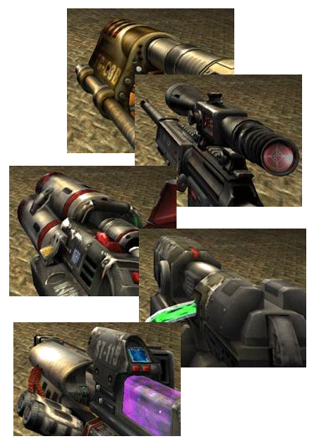
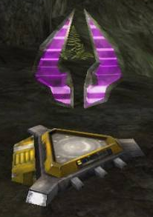
Pogamut 3
Faculty of Mathematics and Physics
Charles University in Prague
11th April 2013
UT2004 bots made easy!
Lecture 7 – Items and Weapons

Slide 3
Warm Up!
Fill the short test for this lessons
6 minutes limit
http://alturl.com/uoq75
https://docs.google.com/forms/d/10Bu4yPY46oebtuMv54yHFx7iQZqJHrpO4BJrHYC_pr4/viewform

Slide 4
Today’s menu
Big Picture
Pogamut World Abstraction
Navigation intermezzo
Items
Weapons introduction

Slide 5
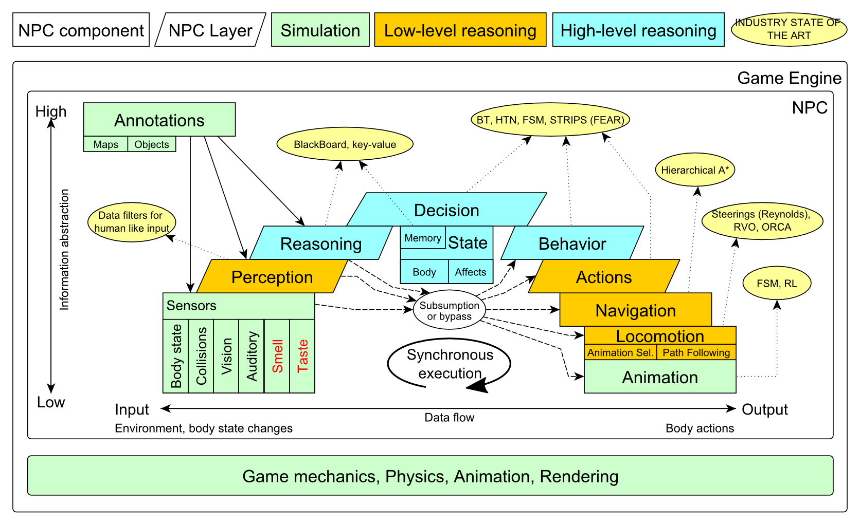
Big Picture Already covered

Slide 6
Big Picture Today

Slide 7
Today’s menu
Big Picture
Pogamut World Abstraction
Navigation intermezzo
Items
Weapons & Shooting

Slide 8
Pogamut World Abstraction Items overview
Objects (IWorldObject):
Player
Item
NavPoint
Self
IncomingProjectile
Events (IWorldEvent):
HearNoise & HearPickup
BotDamaged & BotKilled
PlayerDamaged & PlayerKilled,
ItemPickedUp
GlobalChat
Use modules, listeners and Pogamut helper classes!
this.players, this.items, this.info …
MyCollections, DistanceUtils, fwMap
if (this.items. getSpawnedItems().values().size() > 0) { … }
@EventListener(eventClass = ItemPickedUp.class)
public void itemPickedUp(ItemPickedUp event) {
…
}

Slide 9
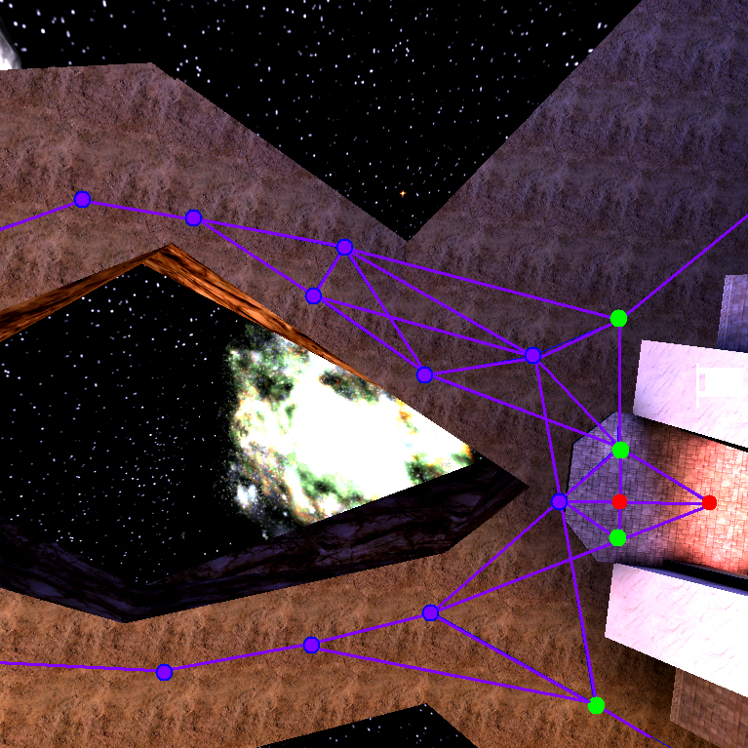
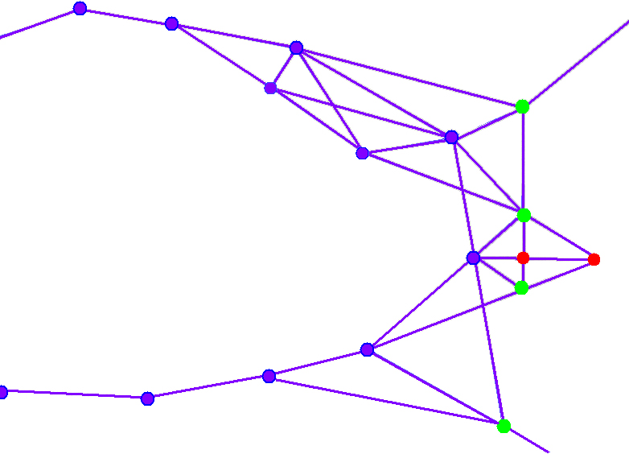
UT2004 World Abstraction Navigation graph
#Navpoints in the map = 100 – 5000

Slide 10
UT2004 World Abstraction Nav link/NavPoint types
NavPoints
InventorySpot
JumpPad
Lift
Teleport
Door
PlayerStart
SnipingSpot
…
Nav links
Walk
Jump
Lift
Door
DoubleJump
…

Slide 11
Today’s menu
Big Picture
Pogamut World Abstraction
Navigation intermezzo
Items
Weapons introduction

Slide 12
Navigation Step by step
General steps:
Decide where to go
Plan the path (list of navpoints)
Follow the path

Slide 13
Navigation Step by step
Improvements:
Decide where to go
Plan the path (list of navpoints)
Follow the path
Watch for meaningfulness!
Check that you have truly grabbed the item!

Slide 14
Navigation Stages
Decide where to go (Decision making!)
items.getSpawnedItems(ItemType)
perform reasoning
It’s OK to compute paths to all spawned items every logic()
Plan and follow the path
this.navigation.navigate(item)

Slide 15
Navigation Stages
Follow the path
Do you still believe that item your running for is spawned?
It might have been picked up by your opponent!
if (!items.isPickupSpawned(item))
{ replan(); }

Slide 16
Navigation Stages
Check that you truly grabbed the item!
UT2004 navigation is not 100% precise
It might stopped running just right before the item!
@EventListener(eventClass = ItemPickedUp.class)
public void itemPickedUp(ItemPickedUp event) {
if (itemRunning.getId().equals(event.getId()) {
// I have picked the item!
}
}

Slide 17
Today’s menu
Big Picture
Pogamut World Abstraction
Navigation intermezzo
Items
Weapons introduction

Slide 18
Items Basics
Item (accesible via this.items !)
More “spawning location” than item
items.isPickupSpawned(item)
Unique UnrealId => Can be used in Set, Map
ILocated ~ getLocation() ~ X, Y, Z
IViewable ~ isVisible()
Always has corresponding NavPoint instance
NavPoint itemNP = item.getNavPoint()
Described by ItemType
item.getType()

Slide 19
Items Important ItemTypes
ItemType.FLAK_CANNON
.MINIGUN
.LIGHTING_GUN
.ROCKET_LAUNCHER
.LINK_GUN
ItemType.SUPER_HEALTH
.SUPER_ARMOR
.SHIELD_PACK
.SUPER_SHIELD_PACK
.U_DAMAGE_PACK

Slide 20
Items ItemType & Categories
ItemType
Enum holding concrete type of the item
Part of some ItemType.Category
Categories are divided based on what items are intended to do
ItemType.Category.HEALTH
ItemType.Category.ARMOR
ItemType.Category.SHIELD
ItemType.Category.WEAPON
ItemType.Category.AMMO

Slide 21
Items Items
Agent module: items
items.getAllItems()
items.getVisibleItems(ItemType)
items.getSpawnedItems(ItemType)
items.isPickable(Item)
DistanceUtils
.getNearest(Collection<Ilocated>)
.getNthNearest(n,Collection<Ilocated>)
fwMap
.getNearestItem(Collection<Item>)

Slide 22
Items ItemDescriptor(s)
Every item is “well” described
Item item = items.getAll(ItemType.Category.WEAPONS).values()
.iterator().next();
WeaponDescriptor weaponDesc =
(WeaponDescriptor)
descriptors.getDescriptor(item.getType());
if (weaponDesc.getPriDamage() > 50) {
…
}
Ammo/Armor/HealthDescriptor available as well

Slide 23
Today’s menu
Big Picture
Pogamut World Abstraction
Navigation intermezzo
Items
Weapons introduction
http://planetunreal.gamespy.com/View.php?view=UT2004GameInfo.Detail&id=26

Slide 24
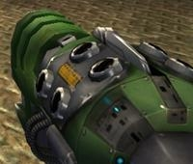
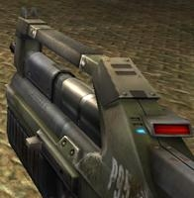
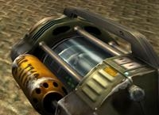
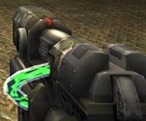
Weapons UT2004 weapons guide I – the weak
ItemType.SHIELD_GUN (DEFAULT)
Melee weapon (can be charged)
Secondary mode – shield
ItemType.ASSAULT_RIFLE (DEFAULT)
Weak, basic, inaccurate (can have two)
Secondary mode – grenades (charged)
ItemType.BIO_RIFLE
Fires green blobs, short range, defense weapon
Secondary mode – charged (big blob)
ItemType.LINK_GUN
Primary fires rather slow, but decent projectiles
Secondary – medium-to-short range beam

Slide 25
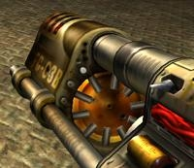
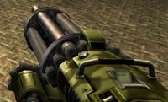
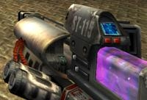
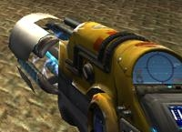
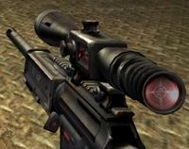
Weapons UT2004 weapons guide II – the strong
ItemType.FLAK_CANNON
Shotgun style weapon – deadly at short range
Sec. mode is a grenade launcher
ItemType.MINIGUN
Choose between rapid fire but less accuracy (pri. mode)
or slower fire and more accuracy (sec. mode)
ItemType.SHOCK_RIFLE
Pri. mode is very accurate with medium damage
Sec. mode fires slow moving projectiles, that can be detonated by pri. fire making a big explosion (tricky to do though)
ItemType.LIGHTING_GUN, SNIPER_RIFLE
Sniper rifle – precise, can one-shot others by a headshot
Bots can use only pri. fire (sec. is zoom)

Slide 26
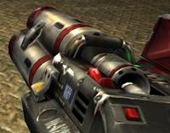
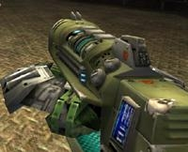
Weapons UT2004 weapons guide III – mayhem
ItemType.ROCKET_LAUNCHER
Good old rocket launcher, rockets have
splash damage (beware!)
Secondary mode can charge up to three rockets
ItemType.REDEEMER
Unleash nuclear mayhem!
big splash damage radius
Bots can use only primary firing mode!
ItemType.U_DAMAGE_PACK
Not enough damage? Grab DOUBLE DAMAGE pack and double your damage output!

Slide 27
Weapons Weaponry class
this.weaponry
All you wanted to know about UT2004 weapons but were afraid to ask
Note that it contains also some obsolete and to-be-deprecated methods…
weaponry.getCurrentWeapon()
weaponry.hasWeapon(ItemType)
weaponry.hasLoadedWeapon()
weaponry.hasPrimaryLoadedWeapon()
weaponry.hasSecondaryLoadedWeapon()
weaponry.getLoadedWeapons()
weaponry.changeWeapon()
…

Slide 28
Assignment 7 (or Homework)
Create CollectorBot
Collects weapons, ammo and armor on the map
Run 3 bots on DM-1on1-Albatross
What if the item you want to pick up is not there? (e.g. you run two collector bots and the other one got it first) ~ items.isPickupSpawned(item)
Re-plan!
How to check that your bot can pick some item?
items.isPickable(Item)
How to check the bot successfully picked up an item?
How to avoid unreachable items?
Use TabooSet

Slide 29
Assignment Cheatsheet
Getting and filtering the items:
this.items.getSpawnedItems(ItemType.Category.WEAPON)
MyCollections.getFiltered(Collection, new IFilter<Item>() {…})
Handling unreachable items:
Navigation.addStrongNavigationListener(…STUCK_EVENT…)
myTabooSet.add() & myTabooSet.filter(…)
Some thin items (e.g. HealthVial) are tricky to pick up! How to be sure that your bot has picked the item up?
ItemPickedUp.class event
@EventListener(eventClass=ItemPickedUp.class)
public void pickedUp(ItemPickepUp event) {}

Slide 30
Questions? I sense a soul in search of answers…
We do not own the patent of perfection (yet…)
In case of doubts about the assignment, tournament or hard problems, bugs don’t hesitate to contact us!
Jakub Gemrot (Monday practice lessons)
jakub.gemrot@gmail.com
Michal Bída (Thursday practice lessons)
michal.bida@gmail.com

Slide 31
DĚKUJI ZA POZORNOST

