Slide 1
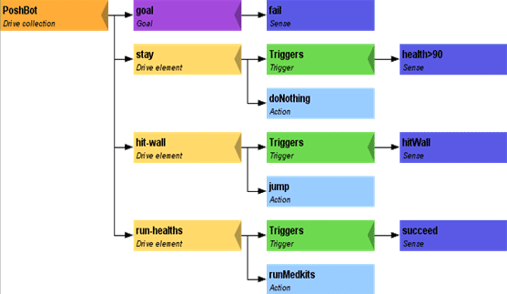
Pogamut 3
Faculty of Mathematics and Physics
Charles University in Prague
25th April 2013
UT2004 bots made easy!
Lecture 9 – BOD, yaPOSH & DeathMatch

Slide 2
Warm Up!
Fill the short test for this lessons
6 minutes limit

Slide 3
NAIL068 Exam
Reserved SW1 for:
Monday 20. 5.2013 – 9:00-15:40
Thursday 23.5.2013 – 9:00-15:40
Exam will last cca 3-4 hours (coding) + 30 minut questionnaires filling + 5 minut „informal chat“
Do the time and date suit you?
Notes:
https://docs.google.com/forms/d/1e14QmiDSnSWdcrHoeen1Rzl80vu2my0Dwf9-1ghJgQ0/viewform

Slide 4
Today’s menu
Big Picture
BOD (Behavior Oriented Design)
Gentle yaPOSH introduction
Weapons & Shooting
DeathMatch Bot

Slide 5
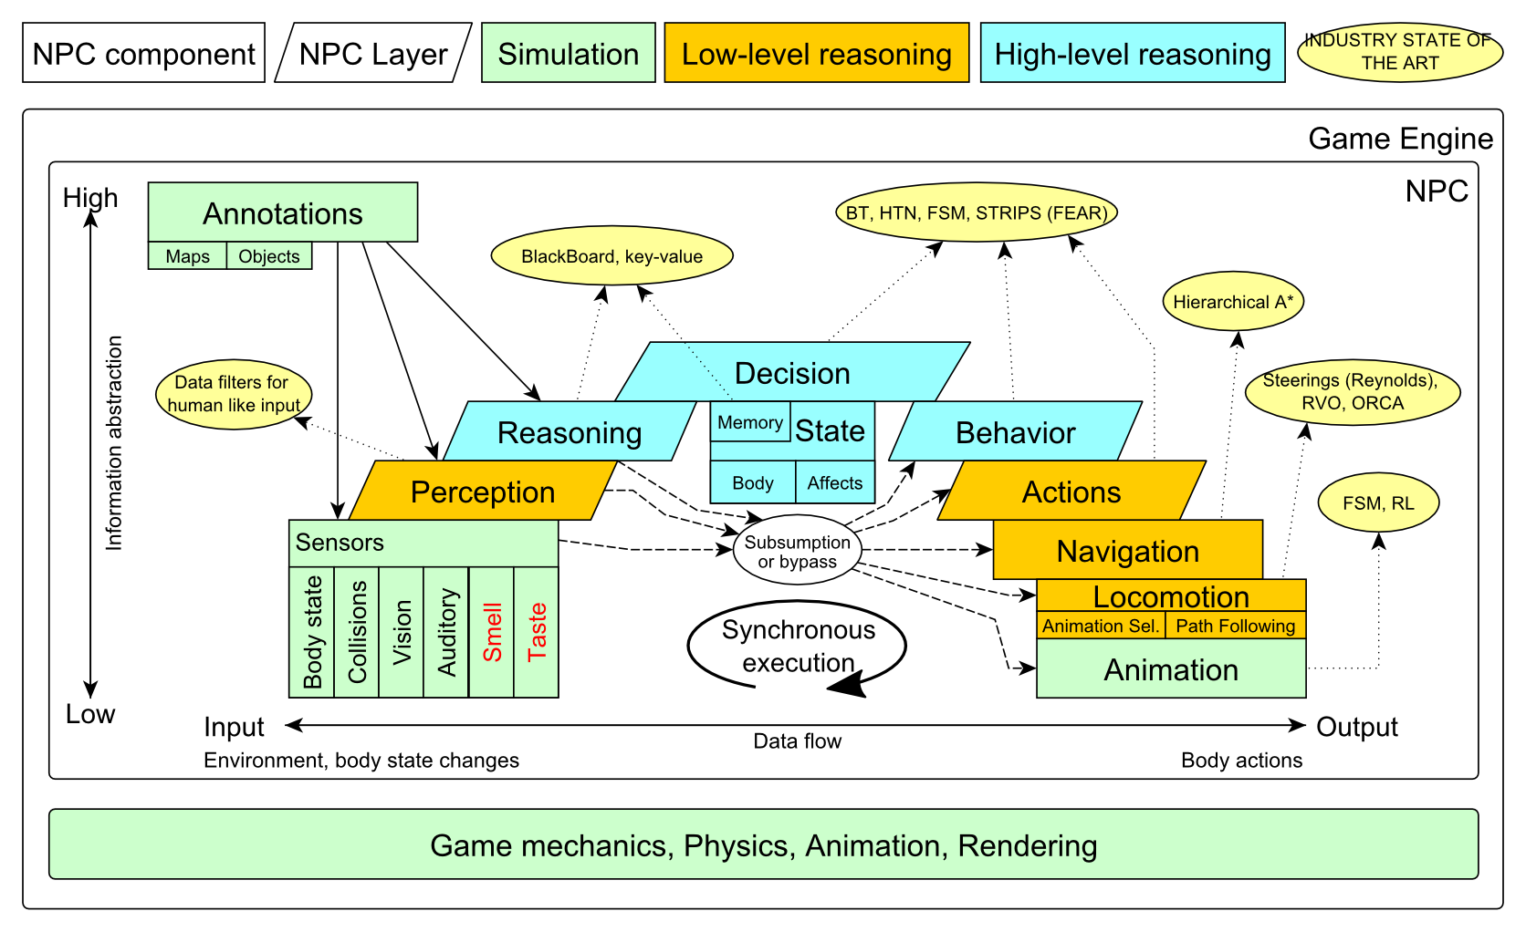
Big Picture Already covered

Slide 6
Big Picture Today

Slide 7
Today’s menu
Big Picture
BOD (Behavior Oriented Design)
Gentle yaPOSH introduction
Weapons & Shooting
DeathMatch Bot

Slide 8
Behavior Oriented Design Methodology
BOD (Behavior Oriented Design)
A methodology for developing control of complex intelligent agents
virtual reality characters, humanoid robots or intelligent environments…
Combines the advantages of Behavior-Based AI and Object Oriented Design.
Authored by Joanna J. Bryson
http://www.cs.bath.ac.uk/~jjb/web/bod.html

Slide 9
How to think? Intelligence by design
Behavior Oriented Design
by Joanna J. Bryson (UK)
http://www.cs.bath.ac.uk/~jjb/web/bod.html
Specify top-level decision
Name the behaviors that the bot should do
Identify the list of sensors that is required to perform the behavior
Identify the priorities of behaviors
Identify behavior switching conditions
Recursion on respective behaviors until primitive actions reached

Slide 10
Behavior Oriented Design BOD in human language
State the goal of you agent behavior
E.g. It will be a Deathmatch bot
Brainstorm what it will mean to fulfill the behavior goal
E.g. fight players, gather items
Think about conditions that should be fulfilled for the respective behaviors
E.g. I’ll fight only when I see enemy and have proper weapon
Revise, revise, revise
Oh wait, what if I don’t have the proper weapon, I should add a behavior to flee from fight and gather some weapon.
Pick one of the specified top level behaviors and apply recursion from point 1!
When you end up with sufficiently simple and clear defined sense/action – NAME IT WELL, implement it and test it!

Slide 11
Behavior Oriented Design Iterative Development
Recursion == Iterative development
Select a part of the plan to extend next.
Extend the agent with that implementation
Extend the plan, code actions and senses
Test and debug that code (!!!)
Revise the current specification.

Slide 12
Behavior Oriented Design Revising BOD Specifications
Name the behaviors (functions) logically!
Good method name is better than documentation!
Reduce code redundancy
Use copy-paste with caution or not at all!
Avoid Complex Conditions
The shorter condition, the better the understanding
Avoid Too Many If-then rules at one level
One level of decision making usually needs no more than 5 to 7 if-then rules, they may contain fewer…
When in doubt, favor simplicity

Slide 13
Practice Lesson Outline
Big Picture
BOD (Behavior Oriented Design)
Gentle yaPOSH introduction
Weapons & Shooting
DeathMatch Bot

Slide 14
yaPOSH Introduction
yaPOSH
yet-another Parallel-rooted, Ordered Slip-stack Hierarchical planner
To put it simply:
a reactive planner working with FIXED, PRE-SET plans
To put it even simpler:
a tool enabling to specify if – then rules with priority in a tree like structure
Advantage:
Makes you think about the behavior in human terms more than the code

Slide 15
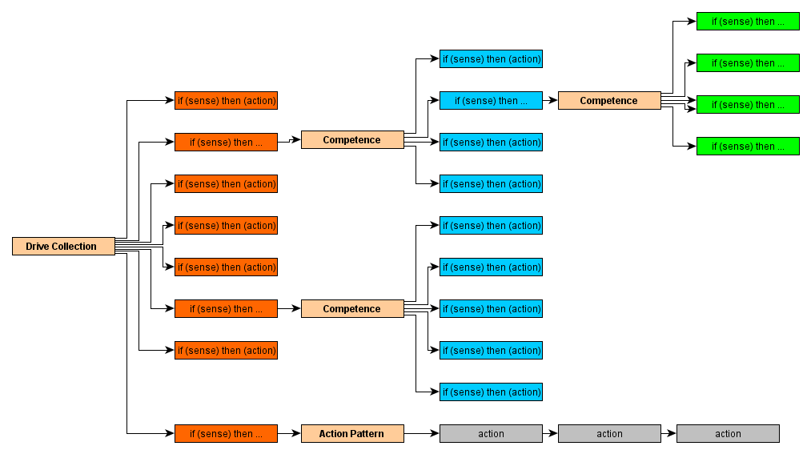
yaPOSH Primitives
Actions and Senses
if (sense) then (action)
Drive Collection (DC)
First level of if-then rules
Competence (C)
Second – Nth level of if-then rules
Action Patterns (AP)
Specifies N actions that will be performed in a sequence

Slide 16
yaPOSH Plan structure (Java glasses)
DriveCollection(
1. if (sense1()) then competence1(); return;
2. if (sense2()) then competence2(); return;
3. if (sense3()) then action-pattern1(); return;
4. if (sense4()) then competence3(); (
1. if (sense5()) then action1(); return;
2. if (sense6()) then competence4(); return;
3. if (sense7()) then action2(); return;
4. if (sense8()) then action-pattern(); return;
5. return;
)
)
ActionPattern(
while (!action1-finished()) {action1(); return;}
while (!action2-finished()) {action2(); return;}
while (!action3-finished()) {action3(); return;}
)

Slide 17
yaPOSH Plan structure (the real)

Slide 18
yaPOSH Senses I
Senses
Represent condition (Do I see a player?)
Return basic types
Boolean, Integer, Double, String, …
Can be queried either as ==, !=, >, <, <= or >=
E.g. cz.cuni.attackbot.FlagIsVisible false !=
Can be parameterized:
MySense extends ParamsSense<BOT_CONTEXT>
public void querry(@Param(“$myParameter”) String myParameter) { … }
cz.cuni.attackbot.MySense($myParameter = “string-value”) false !=

Slide 19
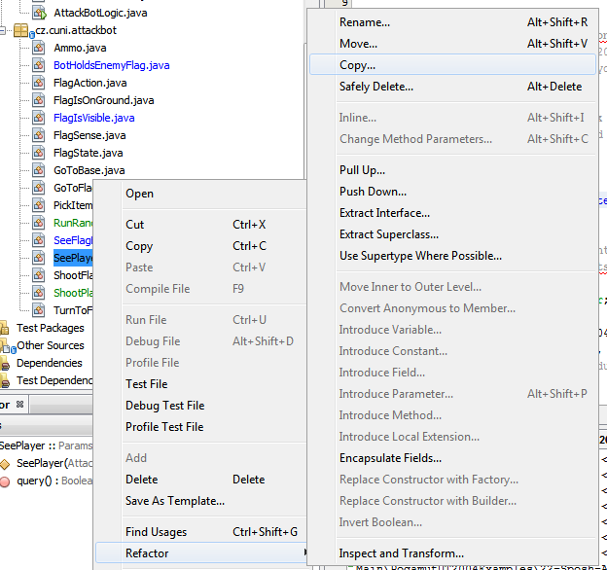
yaPOSH Senses II – New Sense
How to make a new sense?
There are no templates yet…
In NetBeans:
Right click on some existing sense,
Right click the Java class and select refactor and Copy it with a new name
Change the sense description and human readable name in the annotation before the class declaration
In POSH editor click Refresh button in the Senses editor

Slide 20
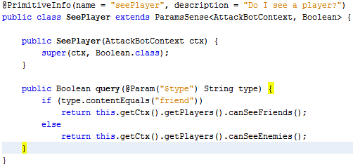
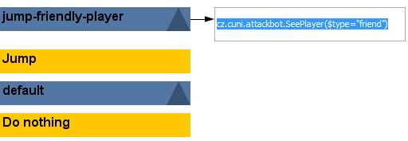
yaPOSH Senses III – Parameterized sense example

Slide 21
yaPOSH Actions I
Actions
Represent an action in the environment
Have three methods – init(), run(), done()
Can be parameterized
need to extend ParamsAction<BOT_CONTEXT>
Parameters passed to init() method, define them with annotation:
public void init(@Param(“$target”) String target) { … }

Slide 22
yaPOSH Actions II
Actions are expected to return their “state” in the run() method – to notify yaPOSH
RUNNING
Action says, I am still running and I want to run in next cycles as well
RUNNING_ONCE
Actions says, I want to be executed for one logic iteration and then I am done
FINISHED
Action says, I am FINISHED and DONE.
This triggers yaPOSH to “replan” – to search for new action –IMMEDIATELLY! (without waiting for the next update from the environment) See next slides for caveats!
Can be used to implement pure „mental“ actions ~ “altering internal state only” action
FAILED
An action execution has failed
This triggers yaPOSH to “replan” – to search for new action –IMMEDIATELLY!

Slide 23
yaPOSH Actions III – yaPOSH action selection
POSH searches for next action to execute as long as it finds one
This means if your plan doesn’t return any action (no sense matches), the POSH will re-evaluate immediately!
And will be stuck in infinite loop!
Your POSH plan should ALWAYS return action!
The best way is to have default sense with action doNothing at the bottom of the plan!
E.g.:

Slide 24
yaPOSH Actions IV – FINISHED
Action returning in run() method FINISHED tells POSH to re-evaluate plan immediately to search for a new action
This can be used to your advantage (parallel actions), but has a caveat!
Consider plan, where StopShooting returns FINISHED in run() immediately:
Makes sense, because as we send stop shoot command in init(), the action is done…
The problem is that the POSH re-evaluates the plan immediately to search for a new action and guess what it finds? StopShooting again. Why?
Because isShooting sense will be returning the same value it was before! The environmental state is not changed. The POSH re-evaluates immediately! We are stuck in infinite loop and no more environmental updates will ever come (even at first glance no exceptions raised).
For these types of actions always return RUNNING_ONCE !

Slide 25
yaPOSH Actions V – Parallel Actions
Returning FINISHED in run() method can be used to your advantage if you are careful enough.
Lets say you want to execute two actions in parallel.
Create an action-pattern (drag and drop from action pattern tab)
Add the actions you want to execute in parallel (in our example StopShooting and Jump). They will be returning FINISHED in run() to trigger immediate POSH re-evaluation
Add one more dummy action to the end of action pattern returning RUNNING_ONCE (to stop POSH plan re-evaluation – otherwise we would be stuck in infinite loop again)
Done! You have now action pattern executing two actions in parallel!

Slide 26
yaPOSH Actions VI – New Action
How to make a new action?
There are no templates yet…
In NetBeans:
Right click on some existing action,
Right click the Java class and select refactor and Copy it with a new name
Change the action description and human readable name in the annotation before the class declaration
In POSH editor click Refresh button in the Senses editor

Slide 27
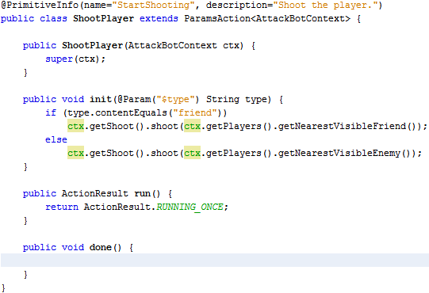
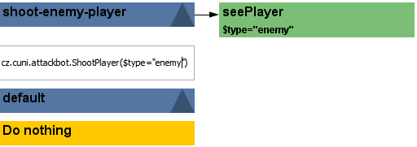
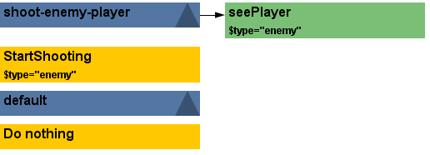
yaPOSH Actions VII – Parameterized Action Example

Slide 28
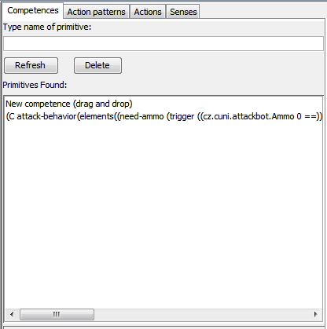
yaPOSH New Action Pattern, New competence
Are created by drag and dropping from POSH editor from the tabs at the right side of IDE

Slide 29
yaPOSH Context How to access Pogamut modules?
Every yaPOSH action and sense has context (this.ctx) that contains all Pogamut modules.
Context is an editable class that is a part of your yaPOSH bot sources, e.g. AttackBotContext
You may use context to store some variables, e.g. Item you are going for or player you are going to fight

Slide 30
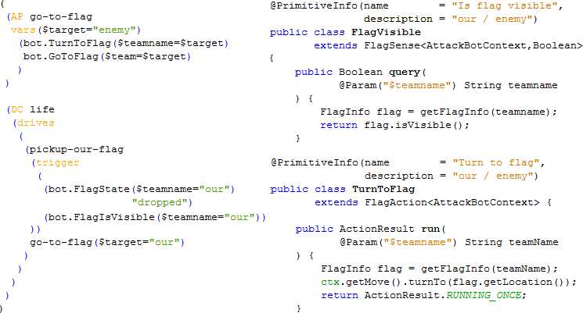
yaPOSH Parameters
Competences, action patterns, actions and senses can be parameterized

Slide 31
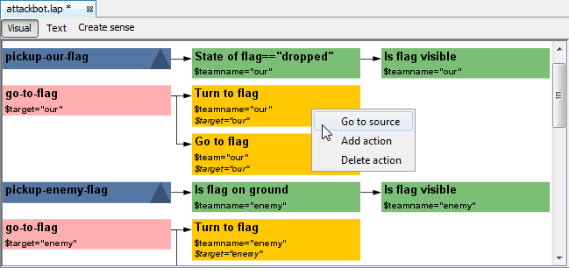
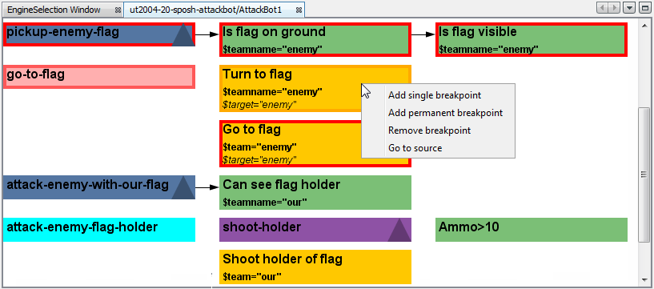
yaPOSH POSH Editor
Enables drag and drop
Select action or sense you want to add or change from the editor and drag and drop it at desired place
Double clicking POSH graphical element open editor, right clicking opens element menu
Support “Go to source”, breakpoints and debugging
Breakpoints PAUSE the bot AND the environment

Slide 32
yaPOSH How to run POSH plan debugger
Run the bot in Debug mode (right click the project, select Debug)
In the Debug toolbar, click the green circle button to enable POSH plan debugger
A window with Debugger appears:

Slide 33
Today’s menu
Big Picture
BOD (Behavior Oriented Design)
Gentle yaPOSH introduction
Weapons & Shooting
http://planetunreal.gamespy.com/View.php?view=UT2004GameInfo.Detail&id=26
DeathMatch Bot

Slide 34
Weapons & Shooting Weaponry class
this.weaponry
All you wanted to know about UT2004 weapons but were afraid to ask
Note that it contains also some obsolete and to-be-deprecated methods…
weaponry.getCurrentWeapon()
weaponry.hasWeapon(ItemType)
weaponry.hasLoadedWeapon()
weaponry.hasPrimaryLoadedWeapon()
weaponry.hasSecondaryLoadedWeapon()
weaponry.getLoadedWeapons()
weaponry.changeWeapon()
…

Slide 35
Weapons & Shooting WeaponPreferences
Weapons’ effectiveness depends on distance to target
Thus you should create different priority list for various “ranges”
Wrapped in class weaponPrefs
weaponPrefs.addGeneralPref(ItemType.MINIGUN, true);
weaponPrefs.addGeneralPref(ItemType.LINK_GUN, false);
true -> primary firing mode
false -> secondary firing mode
weaponPrefs.newPrefsRange(CLOSE_COMBAT_RANGE = 300)
.add(ItemType.FLAK_CANNON, true)
.add(ItemType.LINK_GUN, true); // 0-to-CLOSE
weaponPrefs.newPrefsRange(MEDIUM_COMBAT_RANGE = 1000)
.add(ItemType.MINIGUN, true)
.add(ItemType.ROCKET_LAUNCHER, true); // CLOSE-to-MEDIUM
If range prefs fails, general are used
You have to experiment! (== behavior parametrization!)
More at: http://pogamut.cuni.cz/pogamut_files/latest/doc/tutorials/10-HunterBot.html

Slide 36
Weapons & Shooting Shooting
Shooting with WeaponPrefs is easy!
Player enemy = players.getNearestVisiblePlayer();
shoot.shoot(weaponPrefs, enemy);
shoot.shoot(weaponPrefs, enemy, ItemType.ROCKET_LAUNCHER);
// do not use rocket launcher
shoot.setChangeWeaponCooldown(millis);

Slide 37
Weapons & Shooting Time your shooting – Cooldown class
Sometimes you need to perform the behavior “once in a time” => Cooldown
Cooldown rocketCD = new Cooldown(2000);
// millis
if (rocketCD.isCool()) {
rocketCD.use();
shoot.shoot(weaponPrefs, enemy);
} else {
shoot.shoot(weaponPrefs, enemy, ItemType.ROCKET_LAUNCHER);
}

Slide 38
Weapons & Shooting Time your behaviors – Heatup class
Sometimes you need to pursue some behavior for a while => Heatup
Heatup pursueEnemy = new Heatup(3000);
// millis
if (players.canSeeEnemy()) {
pursueEnemy.heat();
// fight the enemy
} else
if (pursueEnemy.isHot()) {
// pursue the enemy
} else {
// collect items
}

Slide 39
Practice Lesson Outline
Big Picture
BOD (Behavior Oriented Design)
Gentle yaPOSH introduction
Weapons & Shooting
DeathMatch Bot

Slide 40
Deathmatch Bot Basics
Its all about movement on the map
Picking the right place to be at
Picking the right item to go for
Knowing when it is worth to change the behavior
I am almost at the rocket launcher, but I see enemy player. Will I go for the weapon or start fighting with the player?

Slide 41
Deathmatch Bot Combat
Using proper weapon in proper situations
this.weaponPrefs …
Knowing how to move in combat
Strafing, dodging, jumping
Maintaining distance according bot current weapon
Facing one direction and move elsewhere (navigation.setFocus(…))
Beware that jumping and dodging reduces bot accuracy!

Slide 42
Deathmatch Bot Behavior switching
Should you switch from “getting the weapon” into combat behavior?
!!! Depends how far from the weapon you are
Do not switch if you are near… that would be a waste
!!! “NxN” transition conditions in general and there is “no way” around…
Create parameterized sense “mark-behavior”
We’ll be cheating here … it will be “mental” action in fact returning always “false” followed by “do-nothing” action
Create parameterized sense “want-to-switch-to”

Slide 43
Assignment 8 (or Homework)
Evolve DeathMatchBot in yaPOSH more
That arms himself and is able to fight an opponent
Does not stuck (for long)
Assesses behavior switching

Slide 44
Assignment Cheatsheet
Access Pogamut modules from POSH actions and senses!
this.ctx.getItems().getSpawnedItems(ItemType.Category.WEAPON)
MyCollections.getFiltered(Collection, new IFilter<Item>() {…})
Handling unreachable items:
this.ctx.getNavigation().addStrongNavigationListener(…STUCK_EVENT…)
myTabooSet.add() & myTabooSet.filter(…)
Specifying weapon preferences:
this.ctx.getWeaponPrefs().addGeneralPref(ItemType.FLAK_CANNON,true)
.addGeneralPref(ItemType.ROCKET_LAUNCHER,true);

Slide 45
PogamutCup 2013 Sign-up today!
Find us at http://www.pogamutcup.com
DeathMatch 1v1
Sign-up till 1.5.2013
Submit your bot till 13.5.2013
Attend the workshop at 16.5.2013 (free lunch ;-)
Win the prize-money!

Slide 46
Questions? I sense a soul in search of answers…
We do not own the patent of perfection (yet…)
In case of doubts about the assignment, tournament or hard problems, bugs don’t hesitate to contact us!
Jakub Gemrot (Monday practice lessons)
jakub.gemrot@gmail.com
Michal Bída (Thursday practice lessons)
michal.bida@gmail.com

