Slide 1
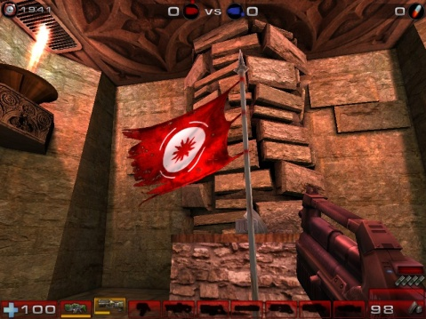
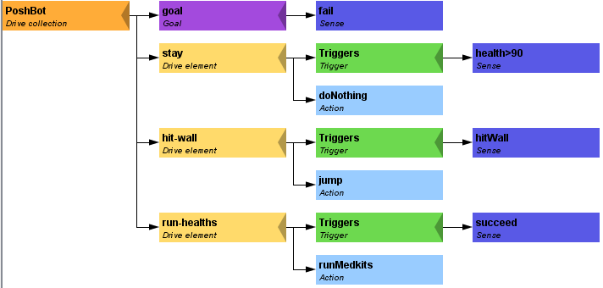
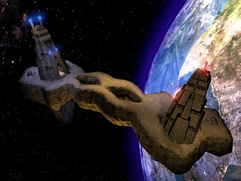
Pogamut 3
Faculty of Mathematics and Physics
Charles University in Prague
2nd May 2013
UT2004 bots made easy!
Lecture 10 – CTF

Slide 2
Warm Up!
Fill the short test for this lesson
6 minutes limit

Slide 3
Today’s menu
Navigation Tips
Capture the Flag (CTF)

Slide 4
Navigation Tips Useful classes
MyCollections
Item targetItem = MyCollections.getRandomFiltered(
items.getSpawnedItems(ItemType.Category.WEAPON), myIFilter
);
fwMap
fwMap.getNearestFilteredItem(…)
DistanceUtils
Heatup
Cooldown

Slide 5
Navigation Tips Anti-stuck I
Always handle STUCK event!
Use TabooSets to temporarily filter items/navpoints you were stuck going to
This prevents your bot to cycle in 1) pick the same item, 2) run towards it, 3) stuck
TabooSet<Item> tabooItems = new TabooSet<Item>(bot);
this.navigation.addStrongNavigationListener(
new FlagListener<NavigationState>() {
@Override
public void flagChanged(NavigationState changedValue){
switch (changedValue) {
case STUCK:
case PATH_COMPUTATION_FAILED:
tabooItems.add(targetItem, 30);
break;
}
}
}
);

Slide 6
Navigation Tips Anti-stuck II
Then don’t forget to use your taboo set to filter the items you are picking from!
if (!this.navigation.isNavigating()) {
targetItem = MyCollections.getRandom(
tabooItems.filter(items.getSpawnedItems().values())
);
this.navigation.navigate(targetItem);
}

Slide 7
Navigation Tips yaPOSH
In yaPOSH, a good place to register navigation state listeners, TabooSets and weapon preferences is in the constructor of bot context class, e.g.:
public AttackBotContext(UT2004Bot bot) {
super("AttackBotContext", bot);
// IMPORTANT: Various modules of context must be initialized.
initialize();
// INITIALIZE CUSTOM MODULES
getWeaponPrefs()…;
…
}

Slide 8
Navigation Tips aStar – plugging the path to navigation
Get starting point
NavPoint from =
navigation.getNearestNavPoint(
info.getLocation()
);
Get target point
NavPoint to =
MyCollections.getRandom(
navPoints.getNavPoints().values()
);
Find the path
List<NavPoint> path =
aStar.findPath(from, to).getPath();
Wrap the path
PrecomputedPathFuture pf =
new PrecomputedPathFuture(from, to, path);
Execute it
this.navigation.navigate(pf);

Slide 9
Today’s menu
Navigation Tips
Capture the Flag (CTF)

Slide 10
Capture the Flag (CTF) Rules
Players/bots are divided into two teams (red and blue).
Each team has a flag in his base.
The goal of the team is to capture the flag of the opposite team and bring it to their home base.
When managed, the team scores 1 point.
Team can only bring opposite flag home and score a point, if the team flag is in team home base!
If the flag is dropped it will be returned to home base after some time.

Slide 11
Pogamut CTF support Bases & game status
CTF module
this.ctf
Where are the bases?
this.ctf.getOurBase();
this.ctf.getEnemyBase();
Whats the game status?
this.ctf.canOurTeamScore();
this.ctf.canEnemyTeamScore();
Am I winning?
game.getTeamScores();
info.getTeamScore();

Slide 12
Pogamut CTF support II Flags
I want my flag!
Flag is represented by FlagInfo object.
this.ctf.getOurFlag();
this.ctf.getEnemyFlag();
Is someone messing with my flag?
this.ctf.isOurFlagHome();
this.ctf.isOurFlagHeld();
How about enemy flag?
this.ctf.isEnemyFlagHome();
this.ctf.isEnemyFlagHeld();

Slide 13
Pogamut CTF support III Team communication
Use SendMessage command.
this.act.act(
new SendMessage()
.setTeamIndex(info.getTeam()).setText(“Help”)
);
Listen to team message with TeamChat event.
@EventListener(eventClass = TeamChat.class)
public void teamChat(TeamChat event) {
…
}

Slide 14
yaPOSH ActionResult.FINISHED WARNING !
Action returning in run() method FINISHED tells yaPOSH to re-evaluate plan immediately to search for a new action
This can be used to your advantage (parallel actions), but has a caveat!
Consider plan, where StopShooting returns FINISHED in run() immediately:
Makes sense, because as we send stop shoot command in run(), the action is done…
The problem is that yaPOSH re-evaluates the plan immediately to search for a new action and guess what it finds? StopShooting again. Why?
Because isShooting sense will be returning the same value it was before! The environmental state is not changed. yaPOSH re-evaluates immediately! We are stuck in infinite loop and no more environmental updates will ever come (even at first glance no exceptions raised).
For these types of actions always return RUNNING_ONCE !

Slide 15
Assignment (or Homework)
Create CTFBot in yaPOSH
Arm yourself before going into action!
Try to get enemy flag!
Try to get your flag, if it is stolen!

Slide 16
Assigment Cheatsheet
Locations of interest
this.ctf.getOurBase();
this.ctf.getEnemyBase();
Useful info about the game (could be senses)
this.ctf.canOurTeamScore();
this.ctf.canEnemyTeamScore();
this.ctf.isEnemyFlagHome();
this.ctf.isOurFlagHeld();
this.ctf.isBotCarryingEnemyFlag();
Our bot
Flag is represented by FlagInfo object
this.ctf.getOurFlag();
Can check isVisible()…

Slide 17
Questions? I sense a soul in search of answers…
We do not own the patent of perfection (yet…)
In case of doubts about the assignment, tournament or hard problems, bugs don’t hesitate to contact us!
Jakub Gemrot (Monday practice lessons)
jakub.gemrot@gmail.com
Michal Bída (Thursday practice lessons)
michal.bida@gmail.com

