Slide 1
EVROPSKÝ SOCIÁLNÍ FOND
Pogamut 3
Lekce 3 – Běhání kolem
PRAHA & EU INVESTUJEME DO VAŠÍ BUDOUCNOSTI

Slide 2
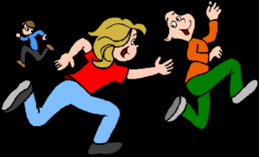
Pogamut 3
Faculty of Mathematics and Physics
Charles University in Prague
11th March 2013
UT2004 bots made easy!
Lecture 3 – Running Around
Tag! Tournament

Slide 3
Warm Up!
Fill the short test for this lessons
5 minutes limit
http://alturl.com/of3kp
Notes:
https://docs.google.com/forms/d/1e14QmiDSnSWdcrHoeen1Rzl80vu2my0Dwf9-1ghJgQ0/viewform

Slide 4
Assignment 2 Revisited Console/FollowBot
private UnrealId followTarget = null;
@EventListener(eventClass = GlobalChat.class)
protected void handleChat(GlobalChat event) {
if (event.getText().contains("hi"))
body.getCommunication()
.sendGlobalTextMessage("Hi");
if (event.getText().contains(“start follow")) {
followTarget = event.getId();
}
if (event.getText().contains(“stop follow”))
followTarget = null;
}
public void logic() throws PogamutException {
if (followTarget != null) {
Player followPlayer = players
.getPlayer(followTarget);
if (info.atLocation(followPlayer.getLocation()) && !followPlayer.isVisible()) {
move.turnHorizontal(30);
} else {
move.moveTo(followPlayer);
}
}
}
Notes:
What happens when the bot is following the player and I type “jump”?

Slide 5
Assignment 2 Revisited Console/FollowBot
private Boolean following = false;
private Boolean jumping = false;
private Boolean searching = false;
private Location search_location;
private Location last_location;
@EventListener(eventClass = GlobalChat.class)
protected void handleChat(GlobalChat event) {
if (event.getText().contains("hi"))
body.getCommunication()
.sendGlobalTextMessage("Hey you");
if (event.getText().contains("follow")) {
this.following = !this.following;
this.searching = false;
}
if (event.getText().contains("jump"))
this.jumping = !this.jumping;
}
public void logic() throws PogamutException {
if (this.following) {
if (this.players.canSeePlayers()) {
Player pl =
this.players.getNearestVisiblePlayer();
this.search_location = pl.getLocation();
this.searching = true;
this.move.moveTo(pl);
} else {
if (searching) {
this.move.moveTo(this.search_location);
if (this.getInfo()
.atLocation(this.search_location))
this.searching = false;
} else
this.move.turnHorizontal(30);
}
}
if (this.jumping) act.act(new Jump());
}
Notes:
What happens when the bot is following the player and I type “jump”?

Slide 6
Motivation >>> Why am I sitting here?
<<< We’re going to dive into PogamutUT2004 platform … technically.
>>> Great, just another proprietary library…
<<< Correct, but:
<<< 1) you have to deal with them everywhere,
<<< 2) platform is created around universal principles, you will learn what to look for in other game engines.
>>> Really… [skeptical face]
<<< We can only show you the door, you are the one who has to go through it… ;-)
Notes:
How many of you are asking yourself this question?
If you do, excellent! You should always be aware whether time you are or were spending is or was worthy.
If you do not, well I would opt for you should begin!
So… what is your answer to this meaning-of-life question?

Slide 7
Today’s menu
Big Picture
How to see
Self, Player, Location, Rotation, Velocity
this.info, this.players
How to move
Move, Jump, Dodge
this.move
Tag! Game
Rules, Map
TagMap
How to think
Intelligence by design
Tag! Tournament Announcement

Slide 8
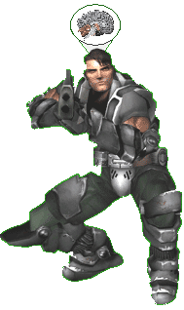
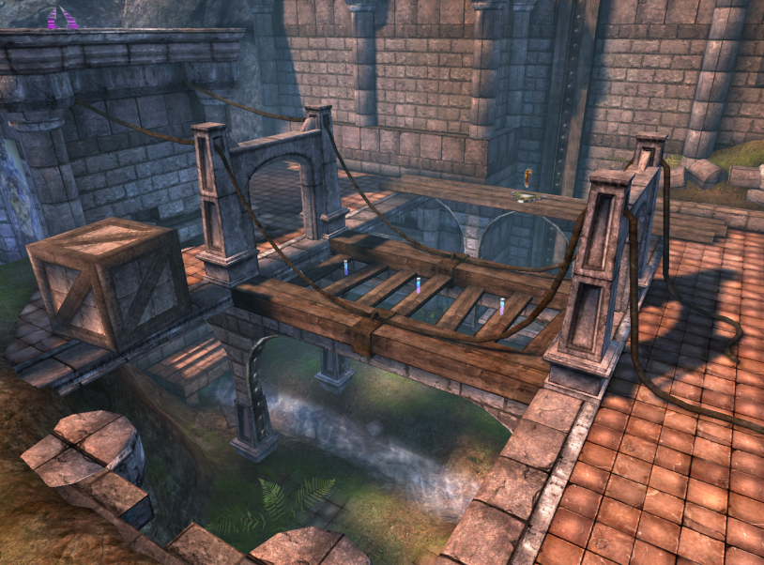
Big Picture
Memory (S)
Environment state (E)
Perception (P)
Action (A)
1. Part of environment state E is exported to the agent p(E) = P
2. Agent performs action-selection: f(P,S) -> AxS
3. Actions are carried out in the environment: a(A^{n},E) -> E
What if we dive deeper?

Slide 9
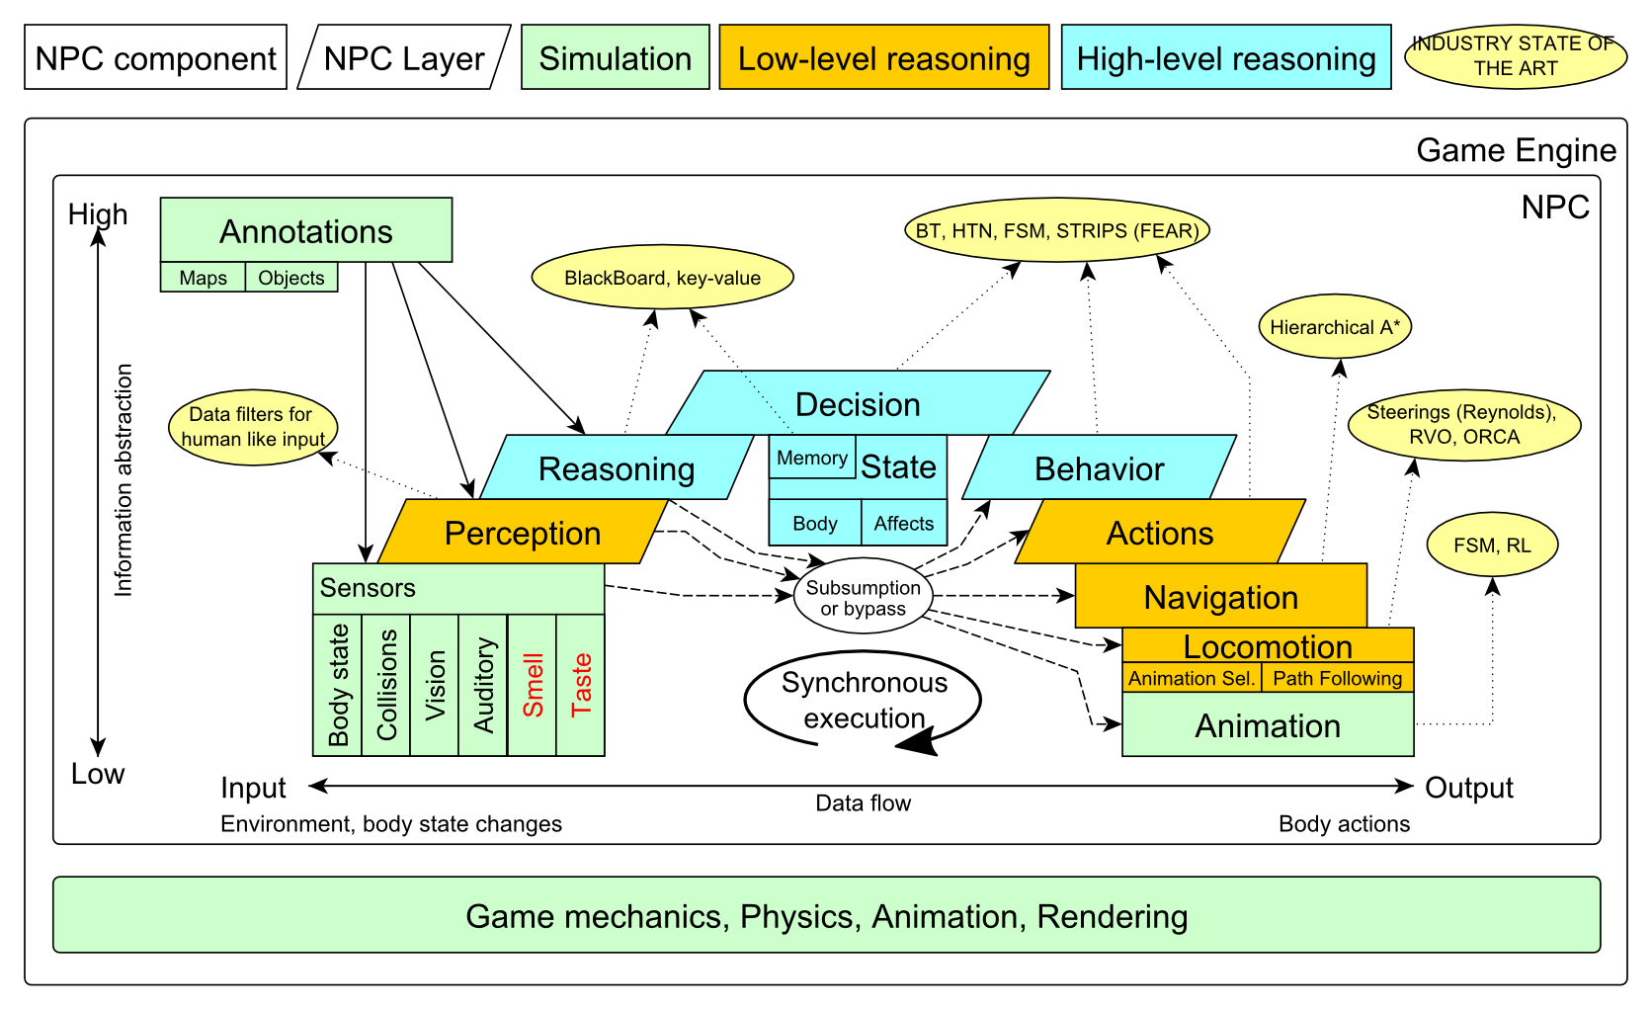
Big Picture

Slide 10
Big Picture Today

Slide 11
Today’s menu
Big Picture
How to see
Self, Player, Location, Rotation, Velocity
this.info, this.players
How to move
Move, Jump, Dodge
this.move
Tag! Game
Rules, Map
TagMap
How to think
Intelligence by design
Tag! Tournament Announcement

Slide 12
How to see? Sensors – Body state, Vision
IWorldObjects
Self, Player, Item, NavPoint, …
this.world.getSingle(Self.class)
this.world.getAll(Player.class)
this.world.getAll(Item.class)
this.world.getAll(NavPoint.class)
Agent modules
AgentInfo ~ this.info
Players ~ this.players
Items ~ this.items
NavPoints ~ this.navPoints
Location, Rotation, Velocity

Slide 13
How to see? Sensors – Body state, Vision
IWorldObjects
Self, Player, Item, NavPoint, …
All objects have unique UnrealId
Each unique id has single UnrealId instance
Each unique object has single instance
Agent modules are respecting this, no sneaky clone()s
What does it mean for Collections?
=> can be used in Set<UnrealId>, Set<Player>
=> can be used as key in Map<UnrealId, ?> , Map<Player, ?> without performance hit

Slide 14
How to see? Sensors – Body state, Vision
IWorldObjects
Self, Player, Item, NavPoint, …
All objects have unique UnrealId
Each unique id has single UnrealId instance
Each unique object has single instance
Agent modules are respecting this, no sneaky clone()s
What does it mean for object updates?
=> once obtained instances are auto-updated
=> there is no history

Slide 15
How to see? Sensors – Body state, Vision
IWorldObjects ~ low-level API
this.world.getSingle(Self.class)
Info about your bot
this.world.getAll(Player.class)
Returns Map<UnrealId, Player>
All players encountered during the session
this.world.getAllVisible(Player.class)
Returns Map<UnrealId, Player>
All players currently visible (in bot’s FOV)
this.world.getAll/Visible(Item.class)
this.world.getAll/Visible(NavPoint.class)
…

Slide 16
How to see? Sensors – Body state, Vision
Agent modules ~ low-level API façades
AgentInfo ~ this.info ~ Self
Players ~ this.players ~ Player(s)
Items ~ this.items ~ Item(s)
NavPoints ~ this.navPoints ~ NavPoint(s)
Advantages:
List of methods with JavaDoc
=> Easier to way to explore Pogamut API
Comprehensibly named methods
=> Easier to read & understand the code

Slide 17
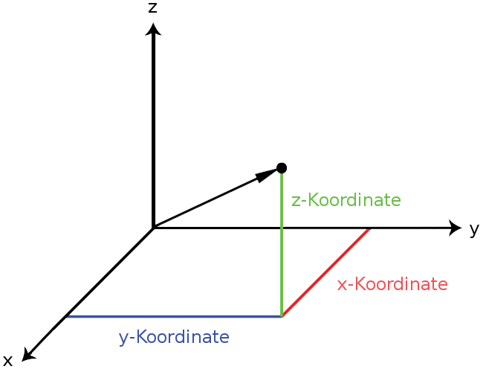
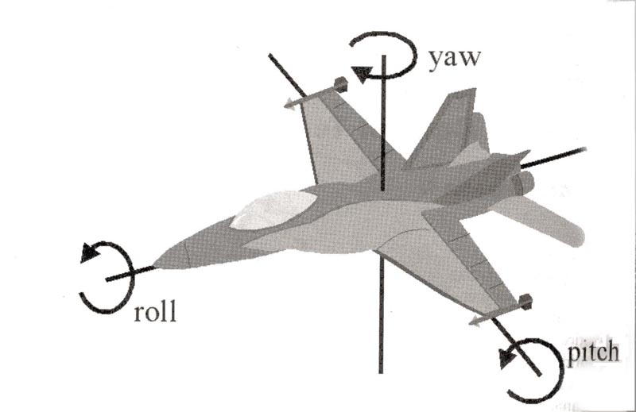
How to see? Sensors – Body state, Vision
Location
X, Y, Z
can be used as “vector”
add(), sub(), scale(), getDistance(), dot(), cross()
rotateXY/XZ/YZ()
Rotation
Pitch (XZ), Yaw (XY), Roll (YZ)
Velocity
X, Y, Z
All objects are immutables
=> Can be used in Set, Map

Slide 18
Today’s menu
Big Picture
How to see
Self, Player, Location, Rotation, Velocity
this.info, this.players
How to move
Move, Jump, Dodge
this.move
Tag! Game
Rules, Map
TagMap
How to think
Intelligence by design
Tag! Tournament Announcement

Slide 19
How to move? Actions
CommandMessages
Move, Jump, Dodge
this.act.act(new Move()…)
this.act.act(new Jump()…)
this.act.act(new Dodge()…)
Agent module
AdvancedLocomotion ~ this.move

Slide 20
How to move? Actions
CommandMessages ~ low-level API
Move
You can specify 1 location in advance
You can specify focus (where to look while moving), i.e., can be used for strafing
Jump
Can be used for double-jumps as well
Dodge
Can be used for quick direct jump to arbitrary location

Slide 21
How to move? Actions
Agent modules ~ low-level API façade
AdvancedLocomotion ~ this.move
All commands wrapped into methods
move.moveTo(), move.strafeTo(), move.jump(), …
Some simple algebra wrapped as well
move.dodgeLeft(), move.dodgeRight(), …

Slide 22
Today’s menu
Big Picture
How to see
Self, Player, Location, Rotation, Velocity
this.info, this.players
How to move
Move, Jump, Dodge
this.move
Tag! Game
Rules, Map
TagMap
How to think
Intelligence by design
Tag! Tournament Announcement

Slide 23
Tag! Game Children play
Custom “game-mode” for UT2004
Two roles:
Seeker (having “it”)
Runner or Prey
Seeker has to chase runners to pass „it“
After passing “it” the former seeker is immune to the new seeker
this.tag agent module
Custom map: DM-TagMap
Simple rectangle map, no obstacles
procedurally decsribed by TagMap static methods

Slide 24
Today’s menu
Big Picture
How to see
Self, Player, Location, Rotation, Velocity
this.info, this.players
How to move
Move, Jump, Dodge
this.move
Tag! Game
Rules, Map
TagMap
How to think
Intelligence by design
Tag! Tournament Announcement

Slide 25
How to think? Intelligence by design
Memory (S)
Environment state (E)
Perception (P)
Action (A)
1. Part of environment state E is exported to the agent p(E) = P
2. Agent performs action-selection: f(P,S) -> AxS
3. Actions are carried out in the environment: a(A^{n},E) -> E
Notes:
Always remember, that it is just a function you’re encoding. Each logic() cycle, you have to check in what state the environment and your body is to be able to give appropriate response.

Slide 26
How to think? Intelligence by design
Behavior Oriented Design
by Joanna J. Bryson (UK)
http://www.cs.bath.ac.uk/~jjb/web/bod.html
Specify top-level decision
Name the behaviors that the bot should do
Identify the list of sensors that is required to perform the behavior
Identify the priorities of behaviors
Identify behavior switching conditions
Recursion on respective behaviors until primitive actions reached

Slide 27
Today’s menu
Big Picture
How to see
Self, Player, Location, Rotation, Velocity
this.info, this.players
How to move
Move, Jump, Dodge
this.move
Tag! Game
Rules, Map
TagMap
How to think
Intelligence by design
Tag! Tournament Announcement

Slide 28
Tag! Tournament Chance to score extra points!
4 bots
1 Seeker, 3 Runners (1 of them will be immune…)
Random groups
Tournament will be held next week, only bots submitted until Sunday 17.3.2013, 23:59 will participate
No shooting allowed, no bot speed reconfigurations allowed

Slide 29
Assignment 3
Download the TagBot project template
Copy ‘map/DM-TagMap.ut2’ into UT2004/Maps folder
Alter UT2004/System/startGamebotsDMServer.bat replacing ‘DM-TrainingDay’ with ‘DM-TagMap’
Implement both TagBot roles
Seeker ~ 5 points
Runner ~ 5 points
Implementations having one role only won’t be accepted (~ 0 points)

Slide 30
Send us finished assignment
Via e-mail:
Subject
“Pogamut homework 2013 – Assignment X”
Replace ‘X’ with the assignment number and the subject has to be without quotes of course
…or face -2 score penalization
To
jakub.gemrot@gmail.com
Jakub Gemrot (Monday practice lessons)
michal.bida@gmail.com
Michal Bída (Thursday practice lessons)
Attachment
Completely zip-up your project(s) folder except ‘target’ directory and IDE specific files (or face -2 score penalization)
Body
Please send us information about how much time it took you to finish the assignment + any comments regarding your implementation struggle
Information won’t be abused/made public
In fact it helps to make the practice lessons better
Don’t forget to mention your full name!

Slide 31
Questions? I sense a soul in search of answers…
We do not own the patent of perfection (yet…)
In case of doubts about the assignment, tournament or hard problems, bugs don’t hesitate to contact us!
Jakub Gemrot (Monday practice lessons)
jakub.gemrot@gmail.com
Michal Bída (Thursday practice lessons)
michal.bida@gmail.com

Slide 32
DĚKUJI ZA POZORNOST

