Slide 1
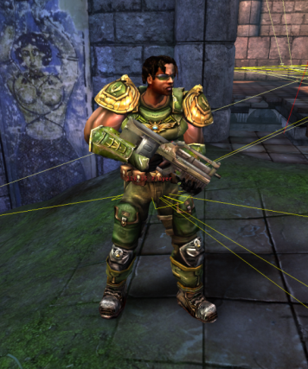
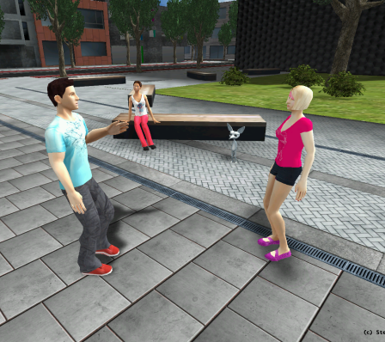
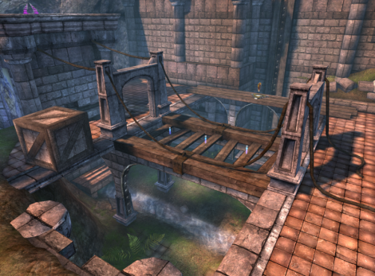
Pogamut 3
Faculty of Mathematics and Physics
Charles University in Prague
10th March 2014
UT2004 bots made easy!
Lecture 2 – Gentle introduction

Slide 2
Warm up
Fill the short test for this lessons
Find the test here (no-ads):
http://goo.gl/0h2lwJ
Permanent link:
https://docs.google.com/forms/d/1uu3X85_pBkeq9PbnhveKzeFwua_VXnPSSdbDqPI4KrQ/viewform
5 minutes limit

Slide 3
Intelligent Virtual Agents What?
Software agent (by Michael Wooldridge)
Embodied intelligent autonomous entity

Slide 4
Intelligent Virtual Agents What?
Software agent (by Michael Wooldridge)
Embodied intelligent autonomous entity
Body that is subject to some (physical) laws
within its environment

Slide 5
Intelligent Virtual Agents What?
Software agent (by Michael Wooldridge)
Embodied intelligent autonomous entity
Operating on an owner's behalf but without
any interference of that ownership entity

Slide 6
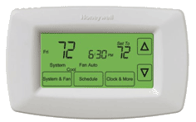
Intelligent Virtual Agents What?
Software agent (by Michael Wooldridge)
Embodied intelligent autonomous entity
Reactive
Proactive
Thermostat may be an agent too!

Slide 7
Intelligent Virtual Agents What?
Software agent (by Michael Wooldridge)
Embodied intelligent autonomous entity
Reactive
Proactive
Social
Okey… ‘more’ thermostats…

Slide 8
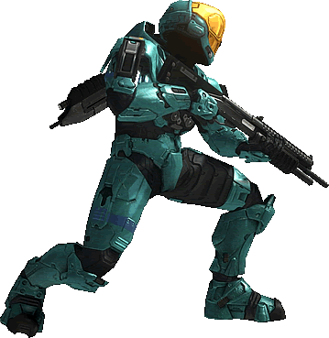
Intelligent Virtual Agents What?
Software agent (by Michael Wooldridge)
Embodied intelligent autonomous entity
Reactive
Proactive
Social
Intelligent Virtual Agent (IVA)
Specific software agent type
Wholly and movably embodied
within Complex virtual environment / world
Acts under bounded rationality

Slide 9
Intelligent Virtual Agents What?
Software agent (by Michael Wooldridge)
Embodied intelligent autonomous entity
Reactive
Proactive
Social
Intelligent Virtual Agent (IVA)
Specific software agent type
Wholly and movably embodied
within Complex virtual environment (… ?)
Acts under bounded rationality

Slide 10
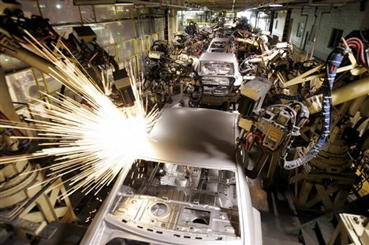
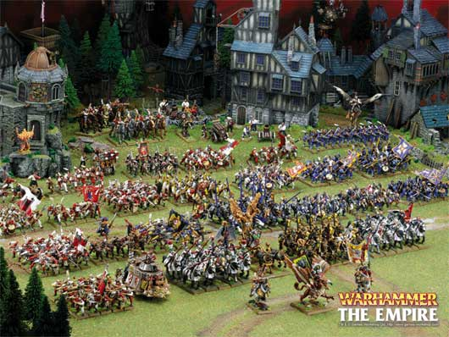
Env. Classification What can be said?
Fully vs. Partially observable
Episodic vs. Sequential
Static vs. Dynamic
Single vs. Multi agent
Deterministic vs. Stochastic
Discrete vs. Continuous
Known vs. Unknown
Turn-based vs. Real-time
Noiseless vs. Noisy

Slide 11
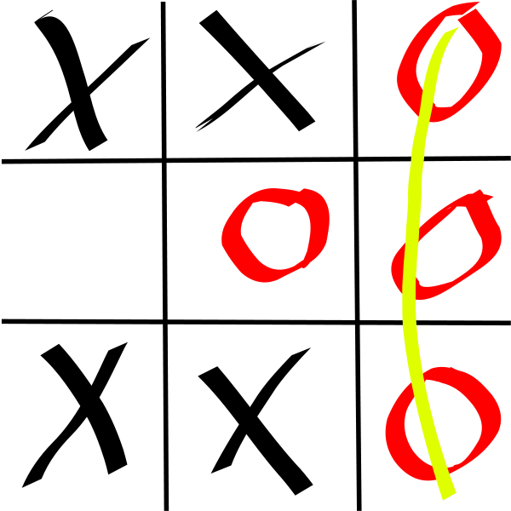
TicTacToe What can be said?
Fully vs. Partially observable
Episodic vs. Sequential
Static vs. Dynamic
Single vs. Multi agent
Deterministic vs. Stochastic
Discrete vs. Continuous
Known vs. Unknown
Turn-based vs. Real-time
Noiseless vs. Noisy

Slide 12
TicTacToe What can be said?
Fully vs. Partially observable
Episodic vs. Sequential
Static vs. Dynamic
Single vs. Multi agent
Deterministic vs. Stochastic
Discrete vs. Continuous
Known vs. Unknown
Turn-based vs. Real-time
Noiseless vs. Noisy

Slide 13
TicTacToe What can be said?
Fully vs. Partially observable
Episodic vs. Sequential
Static vs. Dynamic
Single vs. Multi agent
Deterministic vs. Stochastic
Discrete vs. Continuous
Known vs. Unknown
Turn-based vs. Real-time
Noiseless vs. Noisy

Slide 14
TicTacToe What can be said?
Fully vs. Partially observable
Episodic vs. Sequential
Static vs. Dynamic
Single vs. Multi agent
Deterministic vs. Stochastic
Discrete vs. Continuous
Known vs. Unknown
Turn-based vs. Real-time
Noiseless vs. Noisy

Slide 15
TicTacToe What can be said?
Fully vs. Partially observable
Episodic vs. Sequential
Static vs. Dynamic
Single vs. Multi agent
Deterministic vs. Stochastic
Discrete vs. Continuous
Known vs. Unknown
Turn-based vs. Real-time
Noiseless vs. Noisy

Slide 16
TicTacToe What can be said?
Fully vs. Partially observable
Episodic vs. Sequential
Static vs. Dynamic
Single vs. Multi agent
Deterministic vs. Stochastic
Discrete vs. Continuous
Known vs. Unknown
Turn-based vs. Real-time
Noiseless vs. Noisy

Slide 17
TicTacToe What can be said?
Fully vs. Partially observable
Episodic vs. Sequential
Static vs. Dynamic
Single vs. Multi agent
Deterministic vs. Stochastic
Discrete vs. Continuous
Known vs. Unknown
Turn-based vs. Real-time
Noiseless vs. Noisy

Slide 18
TicTacToe What can be said?
Fully vs. Partially observable
Episodic vs. Sequential
Static vs. Dynamic
Single vs. Multi agent
Deterministic vs. Stochastic
Discrete vs. Continuous
Known vs. Unknown
Turn-based vs. Real-time
Noiseless vs. Noisy

Slide 19
TicTacToe What can be said?
Fully vs. Partially observable
Episodic vs. Sequential
Static vs. Dynamic
Single vs. Multi agent
Deterministic vs. Stochastic
Discrete vs. Continuous
Known vs. Unknown
Turn-based vs. Real-time
Noiseless vs. Noisy

Slide 20
TicTacToe What can be said?
Fully vs. Partially observable
Episodic vs. Sequential
Static vs. Dynamic
Single vs. Multi agent
Deterministic vs. Stochastic
Discrete vs. Continuous
Known vs. Unknown
Turn-based vs. Real-time
Noiseless vs. Noisy

Slide 21
TicTacToe What does it mean?
Fully vs. Partially observable
Episodic vs. Sequential
Static vs. Dynamic
Single vs. Multi agent
Deterministic vs. Stochastic
Discrete vs. Continuous
Known vs. Unknown
Turn-based vs. Real-time
Noiseless vs. Noisy

Slide 22
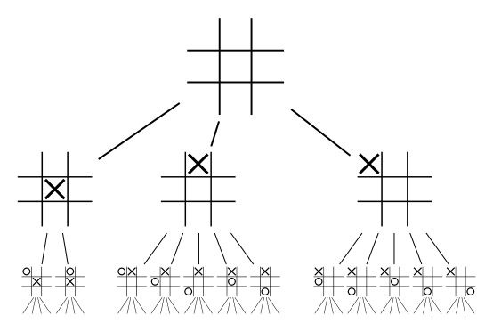
„Reasoning as search“ -- Alan Newell
…
…
…
…
30
-5
100
50
…

Slide 23
„Reasoning as search“ => MIN-MAX algorithm + modifications
-8
10
-10
-5
…
…
…
…
10
30
100
50
75
-5
40
40
30
-10
20
45

Slide 24
Env. of UT2004?
Fully vs. Partially observable
Episodic vs. Sequential
Static vs. Dynamic
Single vs. Multi agent
Deterministic vs. Stochastic
Discrete vs. Continuous
Known vs. Unknown
Turn-based vs. Real-time
Noiseless vs. Noisy

Slide 25
Env. of UT2004 The (almost) worst case imaginable!
Fully vs. Partially observable
Episodic vs. Sequential
Static vs. Dynamic
Single vs. Multi agent
Deterministic vs. Stochastic (weakly)
Discrete vs. Continuous
Known vs. Unknown (weakly)
Turn-based vs. Real-time
Noiseless vs. Noisy

Slide 26
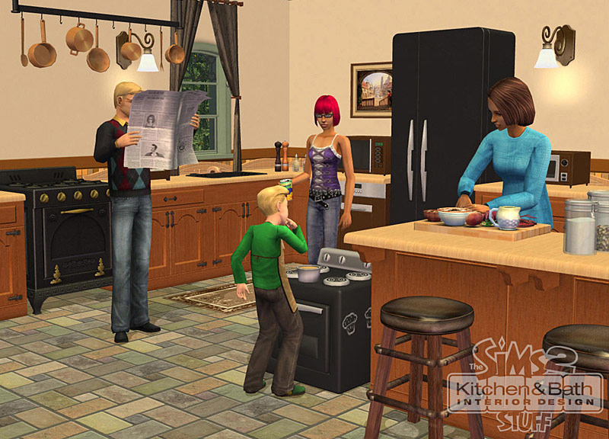
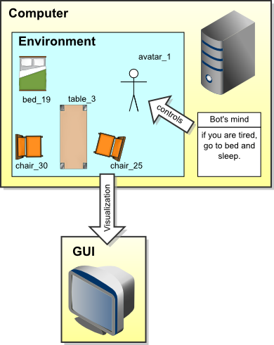
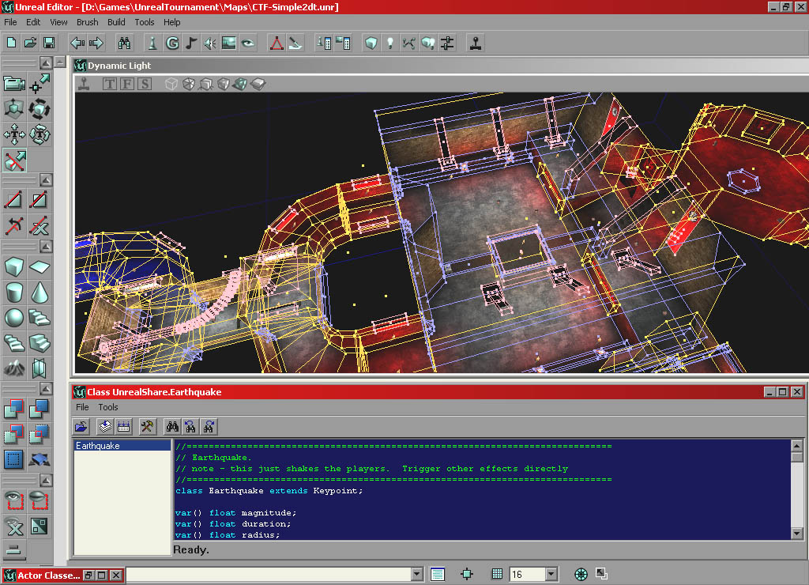
Virtual worlds
GUI

Slide 27
IVAs and Virtual worlds
Memory (S)
Environment state (E)
Perception (P)
Action (A)
1. Part of environment state E is exported to the agent p(E) = P
2. Agent performs action-selection: f(P,S) -> AxS
3. Actions are carried out in the environment: a(A^{n},E) -> E

Slide 28
IVAs and Virtual worlds
Non-complete information
Memory (S)
Environment state (E)
Inaccurate
Perception (P)
Action (A)
Actions mail fail!
Dynamic world
1. Part of environment state E is exported to the agent p(E) = P
2. Agent performs action-selection: f(P,S) -> AxS
3. Actions are carried out in the environment: a(A^{n},E) -> E

Slide 29
Pogamut 3 platform UT2004 and IVAs
UT2004 is providing action execution function a.
GameBots2004 mediates decisions to UT2004 and implements partial observability function p.
Pogamut 3 provides observe function o.
You have to supply reason function r, decide function d and possibly extra memory states S.

Slide 30
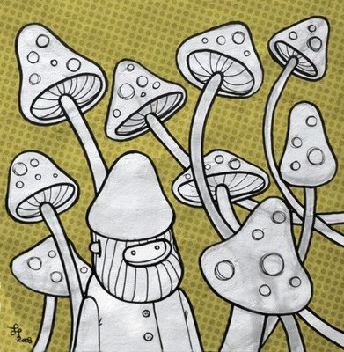
Decision Making Systems
Reactive DMS
Mushroompicker Cyril
Initial state: not_at_home AND picking_mushrooms
IF in_front_of_obstacle THEN change_rotation
IF full_basket AND picking THEN stop_picking
IF see_mushroom AND picking THEN put_it_to_basket
IF noon AND picking THEN stop_picking
IF at_home THEN end
IF picking THEN random_walk
IF not_picking THEN go_home

Slide 31
Pogamut Interface World / Agent
WorldView
A sort of working memory storing all the information bot knows about environment
Or a bot current overview of the world
Access by this.world or this.getWorldView()
Act
Interface enabling to send bot commands – move to location, start shooting, jump, etc.
Access by this.act or this.getAct()

Slide 32
Pogamut API Basics
In JavaDoc
http://pogamut.cuni.cz/pogamut_files/latest/doc/javadoc/
Bot messages
Provide bot with information about environment
All of them are subclasses of InfoMessage object
Bot commands
Allow bot to do things in environment (move, shoot…)
All of them are subclasses of CommandMessage object

Slide 33
Pogamut API Bot messages
Provide information about environment
Two types
IWorldObject vs. IWorldEvent
IWorldObject – persistent object in the game that is typically located (ILocated) and can be seen (IViewable)
Is stored in WorldView
IWorldEvent – marks one event in the environment
Is not stored and can be missed
Listen to events through listeners

Slide 34
Pogamut web
Main web
http://pogamut.cuni.cz/
JavaDoc (IMPORTANT!)
http://pogamut.cuni.cz/pogamut_files/latest/doc/javadoc/
Lecture web
http://pogamut.cuni.cz/pogamut-devel/doku.php?id=lectures
Tutorials
http://pogamut.cuni.cz/pogamut_files/latest/doc/tutorials/
Pogamut manual installation Win32
http://pogamut.cuni.cz/main/tiki-download_file.php?fileId=22
Pogamut on Linux (external)
http://cicolink.blogspot.com/2011/11/unreal-tournament-2004-create-bot-with.html

Slide 35
Installation of Pogamut Step 1: Install Pogamut
Run Pogamut installer found in Download section at
http://pogamut.cuni.cz

Slide 36
Import bot project Step 2: Create new bot project
Follow the tutorial at:
http://pogamut.cuni.cz/pogamut_files/latest/doc/tutorials/OpeningExamples.html

Slide 37
Tutorial 1 – Empty bot
Get the bot from our lecture site
We look into the basics of Pogamut bot methods and API…
See the tutorial:
http://pogamut.cuni.cz/pogamut_files/latest/doc/tutorials/EmptyBotTutorial.html
…
Let’s fool around ☺

Slide 38
Starting Pogamut Bot
Starting the game environment
UT2004 dedicated server
Start->Programs->Vyvojove Nastroje->Pogamut->run GameBots DM server
Starting the vizualizator (the game UT2004)
Start->Programs->Vyvojove Nastroje->Pogamut->run UT2004
Starting the bot itself
Inside NetBeans – right click the project and select Run

Slide 39
Tutorial 2 – Simple bot
Listeners – listening to changes in the environment
See the tutorial:
http://pogamut.cuni.cz/pogamut_files/latest/doc/tutorials/ResponsiveBotTutorial.html
…
Let’s fool around again!

Slide 40
Assignment (or HomeWork)
Extend EmptyBot:
To listen to the player commands
If I say “hi”, bot responds
“Start following” – bot starts following
“Stop following” – bot stops following
Remember last position of the player and if the player is lost, run to that location
If the bot doesn’t see the player, start turning around to scan your surroundings

Slide 41
Assignment (CheatSheat)
Listen to GlobalChat event to receive text messages
Use SendMessage command to send text messages to the game
Module this.players holds information about other players in the game
Module this.move provides basic locomotion commands
You can communicate with your bot from within UT2004 by pressing TAB and typing ‘say hi’ (without quotes)

Slide 42
Send your assignments to
Completely zip-up your project(s) folder
WITHOUT the target folder!
Send it to:
Michal Bída (Monday practice lessons)
michal.bida@gmail.com
Jakub Gemrot (Tuesday practice lessons)
jakub.gemrot@gmail.com

