Slide 1
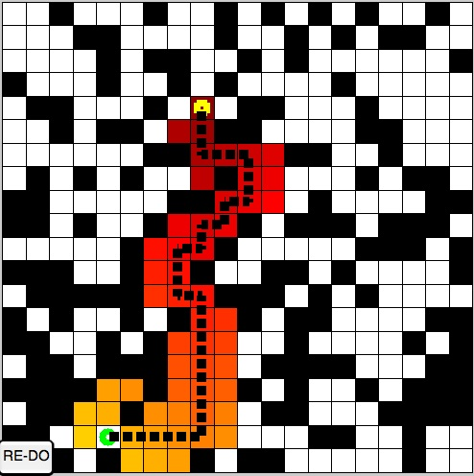
Pogamut 3
Faculty of mathematics and physics
Charles University in Prague
31th March 2015
UT2004 bots made easy!
Lecture 6 – A* + Visibility

Slide 2
Bussiness as usual
Copy UT2004 into D:\
Start downloading the bot:
http://alturl.com/45x9m
http://diana.ms.mff.cuni.cz/pogamut_files/lectures/2014-2015/L6-HideAndSeekBot.zip

Slide 3
Warm Up!
Fill the short test for this lessons
7 minutes
http://alturl.com/gnvbh
https://docs.google.com/forms/d/1GYjpPLj0PaA508jq_H8SPhHqnoguLgaJrhEL8CdACnw/viewform

Slide 4
Assignment 5 Revisited NavigationBot
How to detect that the bot has stuck?
What if the location is currently unreachable?
TabooSet explained

Slide 5
Today’s menu
Big Picture
Visibility abstraction
Visibility matrix
Visibility
this.visibility
How to reason about path
A* and custom map view
UT2004AStar, IPFMapView<NavPoint>
this.aStar
Hide&Seek Game
Rules, Map
HideAndSeekMap
Hide&Seek Tournament Announcement

Slide 6
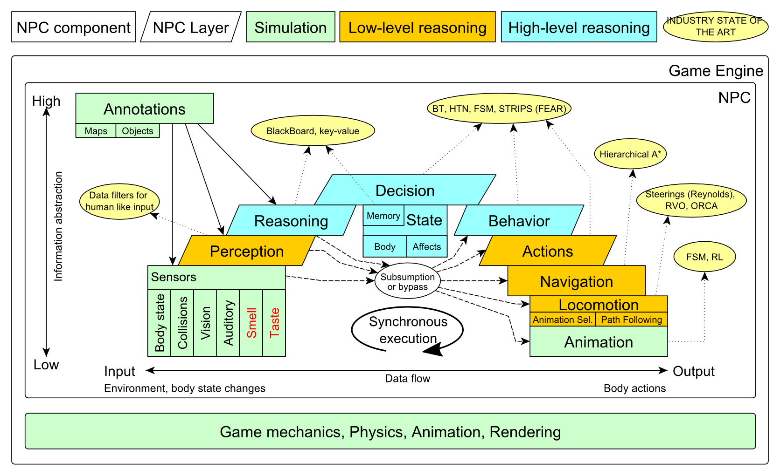
Big Picture Already covered

Slide 7
Big Picture Today

Slide 8
Today’s menu
Big Picture
Visibility abstraction
Visibility matrix
Visibility
this.visibility
How to reason about path
A* and custom map view
UT2004AStar, IPFMapView<NavPoint>
this.aStar
Hide&Seek Game
Rules, Map
HideAndSeekMap
Hide&Seek Tournament Announcement

Slide 9
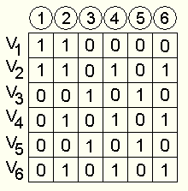
Visibility Abstraction Visibility Matrix
Visibility class
Contains precomputed visibility matrix between path points and some points on links
Matrices for competition maps already present

Slide 10
Visibility Matrix How to get to cover?
How to find the cover?
Enemies …
Safe waypoints …

Slide 11
Visibility Matrix Smart attack
Choose target T
Others are enemies Ei
3. Navpoints other enemies Ei can see
2. Navpoints target T is visible from
4. Smart place to shoot from

Slide 12
Visibility Matrix Interesting methods
Visibility class (this.visibility)
getNearestVisibilityLocationTo(ILocated)
getCoverPointsFrom(ILocated)
getCoverPointsFromN(ILocated…)
getMatrix()
isVisible(ILocated, ILocated)
VisibilityMatrix class
getMatrix()
getNearestIndex(ILocated located)

Slide 13
Visibility Matrix Visibility matrix file
To be able to use the visibility matrix, you need to have a file with the visibility information
Each map has its own file. E.g.
VisibilityMatrix-DM-TrainingDay-all.bin
Place this file in the root of the project folder of your bot
Get all matrices from svn
svn://artemis.ms.mff.cuni.cz/pogamut/trunk/project/Main/PogamutUT2004Examples/19-VisibilityBatchCreator/visibility-matrices

Slide 14
Today’s menu
Big Picture
Visibility abstraction
Visibility matrix
Visibility
this.visibility
How to reason about path
A* and custom map view
UT2004AStar, IPFMapView<NavPoint>
this.aStar
Hide&Seek Game
Rules, Map
HideAndSeekMap
Hide&Seek Tournament Announcement

Slide 15
A* Algorithm Reasoning
Agent deliberation cycle
Update senses
Some Players have become visible
Update percepts
They are all enemies!
Reason
Where can I take cover? How can I fallback?
=> Infer new information given the senses / percepts
Decide
Inform my team then … should I take cover, fallback or attack?
Take action

Slide 16
A* Algorithm Dijkstra
Remembering Dijkstra’s alg?
Roughly speaking…
Nodes = {start}
while (!nodes.empty) {
Node = pick_shortest_path(nodes)
if (Node == Target) return reconstruct_path(Node)
Nodes = Nodes \ Node
expand(Node, Nodes)
}

Slide 17
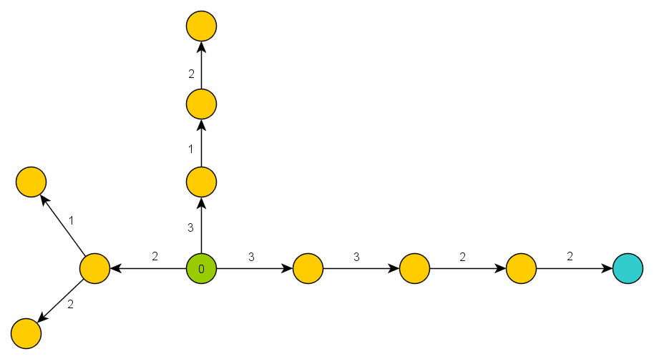
A* Algorithm Dijkstra Example I

Slide 18
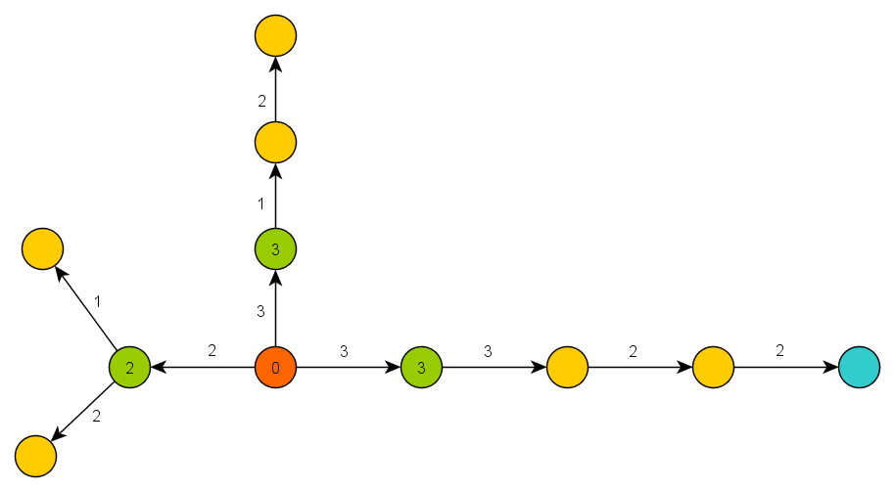
A* Algorithm Dijkstra Example II

Slide 19
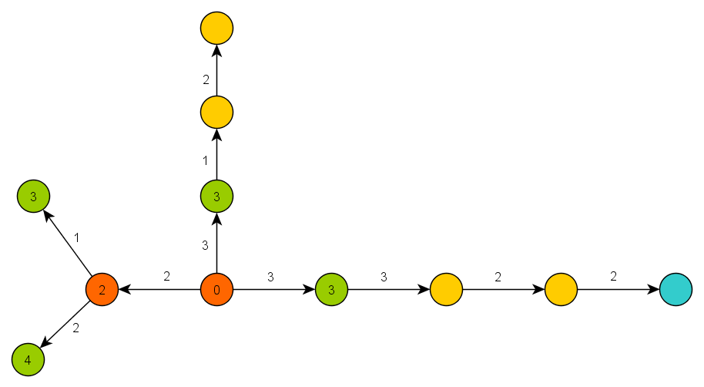
A* Algorithm Dijkstra Example III

Slide 20
A* Algorithm Basics
A* trick
Roughly speaking…
Nodes = {start}
while (!nodes.empty) {
Node = pick_the_most_promising(nodes)
if (Node == Target) return reconstruct_path(Node)
Nodes = Nodes \ Node
expand(Node, Nodes)
}

Slide 21
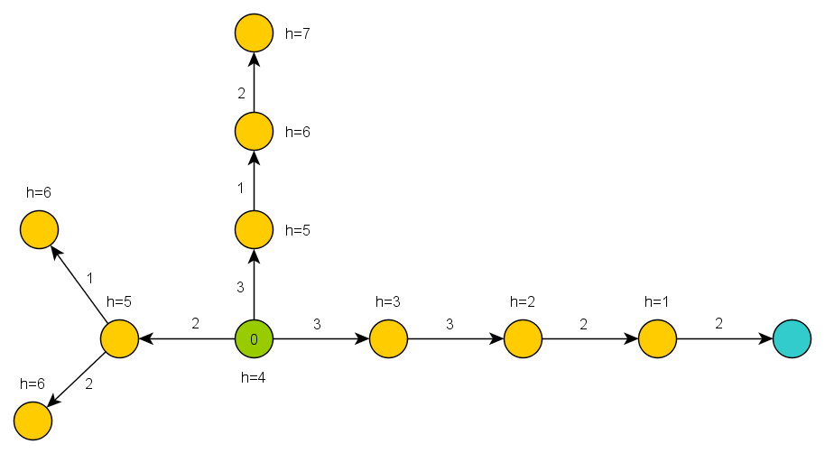
A* Algorithm A* Example I

Slide 22
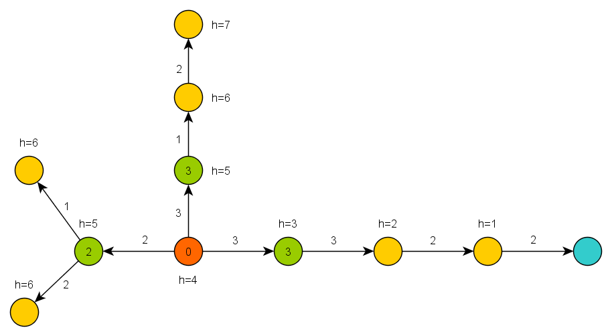
A* Algorithm A* Example II

Slide 23
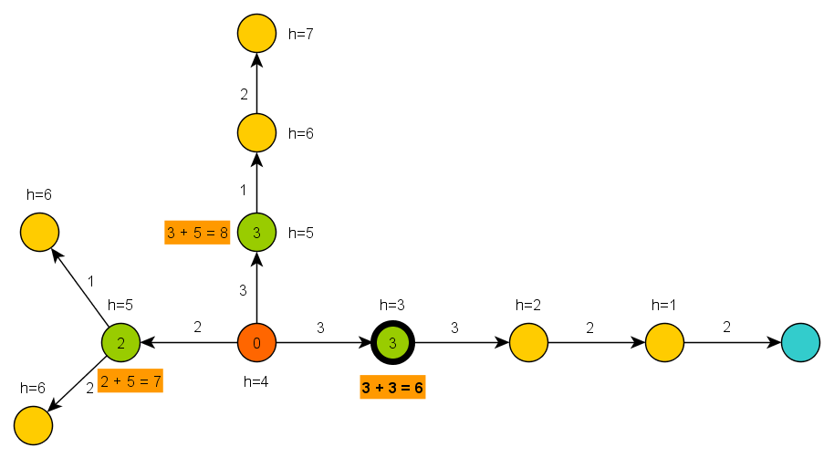
A* Algorithm A* Example III

Slide 24
A* Algorithm Basics
A* heuristic function must be… ?
Admissible for correctness
Do not over-estimate the path-cost
Consistent == Monotone (for efficiency)
“triangle inequation”
Blah! Let’s hack it!
What if we impose additional COST to some nodes or links?

Slide 25
A* Algorithm Juggling with node/link costs
Len(path) … path length
min-Len-Path(N,M) … shortest path between N and M
B … bad node/link B
EB … extra cost visiting/traversing B
Cost(path) … path cost (based on Len(path)) including EB
min-Cost-Path(N,M) … the least cost path between N and M
What P-Len(N,M) and P-Cost(N,M) look like?
P-Len(N,M) == P-Cost(N,M)
There does not exist other path p(N,M) not-including B satisfying
Len(p(N,M)) < Len(P-Len(N,M)) + EB
P-Len(N,M) != P-Cost(N,M)
We have found Len-longer path that does not traverse B satisfying
Len(P-Cost(N,M)) < Len(P-Len(N,M)) + EB

Slide 26
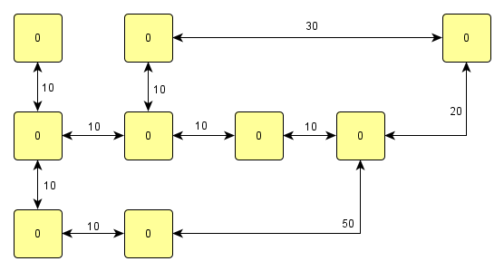
A* Algorithm Juggling with node/link costs
Example map

Slide 27
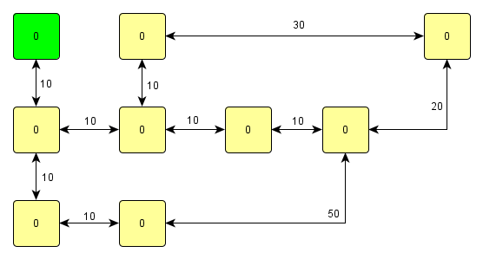
A* Algorithm Juggling with node/link costs
Start-node

Slide 28
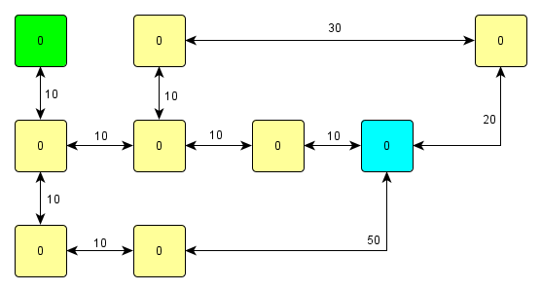
A* Algorithm Juggling with node/link costs
Target-node

Slide 29
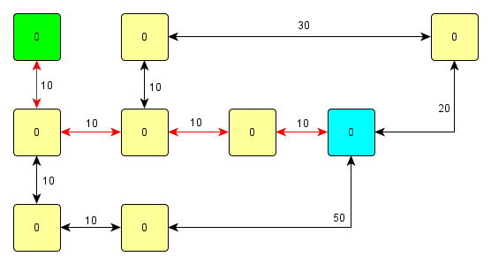
A* Algorithm Juggling with node/link costs
Shortest path

Slide 30
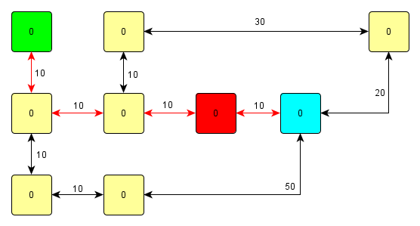
A* Algorithm Juggling with node/link costs
Adversary we want to avoid

Slide 31
A* Algorithm Juggling with node/link costs
Let’s rise the NODE cost … is it enough?

Slide 32
A* Algorithm Juggling with node/link costs
No…

Slide 33
A* Algorithm Juggling with node/link costs
Rise the NODE cost again… enough now?

Slide 34
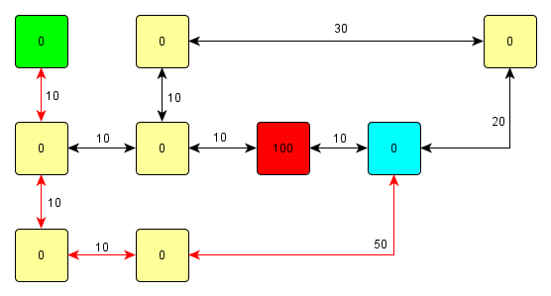
A* Algorithm Juggling with node/link costs
Here you go!
Why was this path found?
Notes:
May be we’re cheating ☺ …

Slide 35
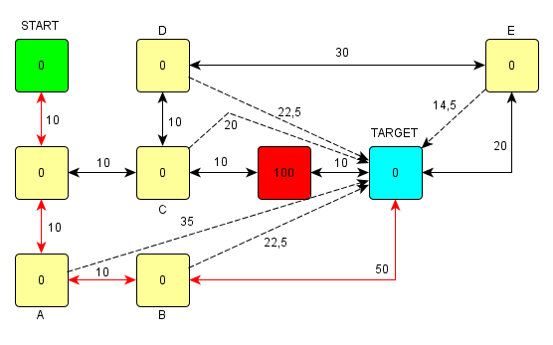
A* Algorithm Juggling with node/link costs
Adding important heuristic costs
So, are we cheating or not?
Notes:
We’re not cheating ☺
The A* algorithm will:
Will expand C before B
Then expand D
Then expand A and B thus getting to TARGET … so |START-TARGET| == 80 through B
Then E is expanded but found path to TARGET through E is not shorter then already found path through B, so it is not overridden
TARGET is visited and the path is found

Slide 36
A* Algorithm Map cost tricks
Combine it with enemy position!
extra cost = 500 / distance-to-enemy
Combine it with Visibility class!
boolean visibility.isVisible(ILocated, ILocated)
Combine both enemy position and the visibility!
Combine with already-found path + fwMap and find different paths!
Play with the cost iteratively
Different path not found? Ok, just rise the cost…
Does different path even exist?
=> Try to “forbid” some node/link completely

Slide 37
A* Algorithm Pogamut 3 Classes
UT2004AStar
this.aStar.findPath( from, to, IPFMapView );
Implement your own custom IPFMapView:
new IPFMapView<NavPoint>() {
public int getNodeExtraCost(NavPoint node, int mapCost) {}
public int getArcExtraCost(NavPoint nodeFrom, NavPoint nodeTo, int mapCost) {}
public Collection<NavPoint> getExtraNeighbors(NavPoint node, Collection<NavPoint> mapNeighbors) {}
public boolean isNodeOpened(NavPoint node) {}
public boolean isArcOpened(NavPoint nodeFrom, NavPoint nodeTo) {}
}

Slide 38
Today’s menu
Big Picture
Visibility abstraction
Visibility matrix
Visibility
this.visibility
How to reason about path
A* and custom map view
UT2004AStar, IPFMapView<NavPoint>
this.aStar
Hide&Seek Game
Rules, Map
HideAndSeekMap
Hide&Seek Tournament Announcement

Slide 39
Hide&Seek Game Children play
Custom “game-mode” for UT2004
Two roles:
Seeker (having “it”)
Runner
Seeker has to find runners and then get home (safe point) first to “capture them”
Runners have to make it home (to safe point) before Seeker
this.hide agent module
Custom map: DM-HideAndSeekMap

Slide 40
Hide&Seek Game Rules specifics
One match = 4 games of 10 rounds each of hide and seek with fixed seeker for each game
1 round = 90 seconds (first 8 seconds hide time, next 5 seconds restricted safe area time)
Spotting
Seeker “spots” runner when he sees him for at least 600 ms (cca “two logic() ticks”)
Seeker is spawned into the map after first 8 seconds
Safe area
Runners are not allowed to dwell around safe point for certain amount of time at the beginning of the game (5 seconds)

Slide 41
Hide&Seek Game Task point rewards
Scoring RUNNER
Runner captured by seeker -10
Runner fouled (went into safe area before timeout) -1000
Runner made it to safe area before seeker 150
Runner survived round (haven’t been captured by seeker) 50
Scoring SEEKER
Seeker captured runner (spotted + made it to s. a. first) 250
Runner spotted 50
Runner escaped (made it to safe area before seeker) -20
Runner survived (neither of them made it to safe area) -10
Seeker fouled (dwelled in restricted area > 7 secs) -100

Slide 42
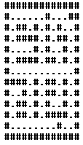
Hide&Seek Game Custom map
DM-HideAndSeekMap

Slide 43
Today’s menu
Big Picture
Visibility abstraction
Visibility matrix
Visibility
this.visibility
How to reason about path
A* and custom map view
UT2004AStar, IPFMapView<NavPoint>
this.aStar
Hide&Seek Game
Rules, Map
HideAndSeekMap
Hide&Seek Tournament Announcement

Slide 44
Hide&Seek Tournament Chance to score extra points!
4 bots
1 Seeker, 3 Runners
Random groups, Fixed map
Fixed Seeker - 4 matches per group
Only bots submitted until Sunday 12.4.2014, 8:00 will participate
No shooting allowed, no bot speed reconfigurations allowed, no manual respawns allowed

Slide 45
Assignment 6 Hide&Seek Bot
Create Hide&Seek Bot
Implement both Seeker and Runner
Tournament will be played on a different map, so we do not recommend using “static” information e.g. run to [1000,200,100] ☺
To run the hide and seek match launch HideAndSeekGame class!
For the tournament name the bot with your name in getInitializeCommand() method

Slide 46
Send us finished assignment
Via e-mail:
Subject
“Pogamut homework 2015 – Assignment X”
Replace ‘X’ with the assignment number and the subject has to be without quotes of course
…or face -2 score penalization
To
jakub.gemrot@gmail.com
Jakub Gemrot (Tuesday practice lessons)
Attachment
Completely zip-up your project(s) folder except ‘target’ directory and IDE specific files (or face -2 score penalization)
Body
Please send us information about how much time it took you to finish the assignment + any comments regarding your implementation struggle
Information won’t be abused/made public
In fact it helps to make the practice lessons better
Don’t forget to mention your full name!

Slide 47
Questions? I sense a soul in search of answers…
We do not own the patent of perfection (yet…)
In case of doubts about the assignment, tournament or hard problems, bugs don’t hesitate to contact us!
Jakub Gemrot (Tuesday practice lessons)
jakub.gemrot@gmail.com

