Slide 1
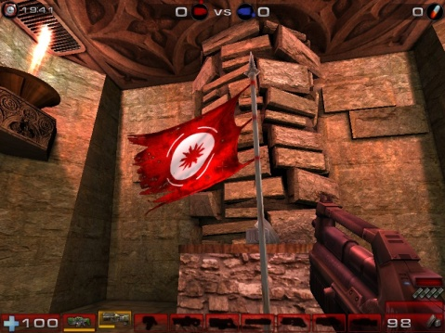
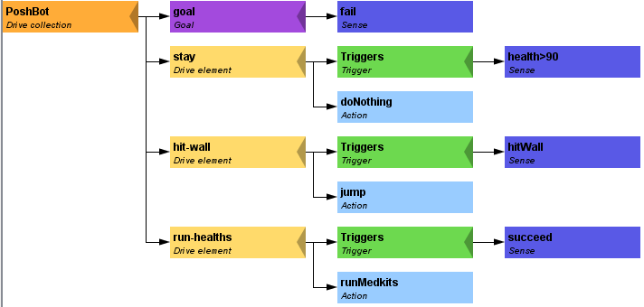
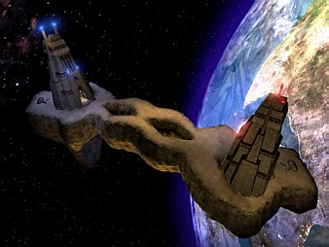
Pogamut 3
Faculty of Mathematics and Physics
Charles University in Prague
30th April 2015
UT2004 bots made easy!
Lecture 10 – CTF

Slide 2
Warm Up!
Fill the short test for this lessons
8 minutes limit
http://alturl.com/vyyr6
https://docs.google.com/forms/d/1VTe2jiXMfU5H0mtVgrKFDvQvNwfLDZhous_U_pHbXnc/viewform

Slide 3
Today’s menu
Navigation Tips
Capture the Flag (CTF)

Slide 4
Navigation Tips Useful classes
MyCollections
Item targetItem = MyCollections.getRandomFiltered(
items.getSpawnedItems(UT2004ItemType.Category.WEAPON), myIFilter
);
fwMap
fwMap.getNearestFilteredItem(…)
DistanceUtils
Heatup
Cooldown

Slide 5
Navigation Tips Anti-stuck I
Always handle STUCK event!
Use TabooSets to temporarily filter items/navpoints you were stuck going to
This prevents your bot to cycle in 1) pick the same item, 2) run towards it, 3) stuck
TabooSet<Item> tabooItems = new TabooSet<Item>(bot);
this.navigation.addStrongNavigationListener(
new FlagListener<NavigationState>() {
@Override
public void flagChanged(NavigationState changedValue){
switch (changedValue) {
case STUCK:
case PATH_COMPUTATION_FAILED:
tabooItems.add(targetItem, 30);
break;
}
}
}
);

Slide 6
Navigation Tips Anti-stuck II
Then don’t forget to use your taboo set to filter the items you are picking from!
if (!this.navigation.isNavigating()) {
targetItem = MyCollections.getRandom(
tabooItems.filter(items.getSpawnedItems().values())
);
this.navigation.navigate(targetItem);
}

Slide 7
Navigation Tips yaPOSH
In yaPOSH, a good place to register navigation state listeners, TabooSets and weapon preferences is in the constructor of bot context class, e.g.:
public AttackBotContext(UT2004Bot bot) {
super("AttackBotContext", bot);
// IMPORTANT: Various modules of context must be initialized.
initialize();
// INITIALIZE CUSTOM MODULES
getWeaponPrefs()…;
…
}

Slide 8
Navigation Tips aStar – plugging the path to navigation
Get starting point
NavPoint from =
navigation.getNearestNavPoint(
info.getLocation()
);
Get target point
NavPoint to =
MyCollections.getRandom(
navPoints.getNavPoints().values()
);
Find the path
IPathFuture pf =
aStar.computePath(from, to);
Execute it
this.navigation.navigate(pf);

Slide 9
Today’s menu
Navigation Tips
Capture the Flag (CTF)

Slide 10
Capture the Flag (CTF) Rules
Players/bots are divided into two teams (red and blue).
Each team has a flag in his base.
The goal of the team is to capture the flag of the opposite team and bring it to their home base.
When managed, the team scores 1 point.
Team can only bring opposite flag home and score a point, if the team flag is in team home base!
If the flag is dropped it will be returned to home base after some time.

Slide 11
Pogamut CTF support Bases & game status
CTF module
this.ctf
Where are the bases?
this.ctf.getOurBase();
this.ctf.getEnemyBase();
Whats the game status?
this.ctf.canOurTeamScore();
this.ctf.canEnemyTeamScore();
Am I winning?
game.getTeamScores();
info.getTeamScore();

Slide 12
Pogamut CTF support II Flags
I want my flag!
Flag is represented by FlagInfo object.
this.ctf.getOurFlag();
this.ctf.getEnemyFlag();
Is someone messing with my flag?
this.ctf.isOurFlagHome();
this.ctf.isOurFlagHeld();
How about enemy flag?
this.ctf.isEnemyFlagHome();
this.ctf.isEnemyFlagHeld();

Slide 13
Pogamut CTF support II Flags
How to set team for my bots?
static int botCount = 0;
@Override
public Initialize getInitializeCommand() {
return new Initialize()
.setName("CTFBot")
.setTeam((botCount++ % 2 == 0) ?
AgentInfo.TEAM_BLUE :
AgentInfo.TEAM_RED);
}
public static void main(String[] args) throws PogamutException
{
new UT2004BotRunner(DuelBotLogic.class, “CTFBot")
.setMain(true)
.setLogLevel(Level.WARNING)
.startAgents(4);
}
}

Slide 14
Pogamut CTF support III (Crude) Team communication
Use SendMessage command.
this.act.act(
new SendMessage()
.setTeamIndex(info.getTeam()).setText(“Help”)
);
Listen to team message with TeamChat event.
@EventListener(eventClass = TeamChat.class)
public void teamChat(TeamChat event) {
…
}
OLD AND SLOW

Slide 15
Capture The Flag The Strategy
Divide area to HOME | MID | ENEMY
Find shortest-paths between NavPoint and the home/enemy base, assess their ratio
At HOME => So called DEFENDER
At MID => So called ROAMER
At ENEMY => So called ATTACKER
Find “different paths” between HOME/ENEMY base
Find shortest path
Use AStar to find other paths (distance between navpoint and existign paths must be greater than N)
Use UT2004Draw to visualize found path
E.g. debug this code separately from the bot’s code

Slide 16
Assignment (or Homework)
Create CTFBot in yaPOSH
Arm yourself before going into action!
Try to get enemy flag!
Try to get your flag, if it is stolen!
Use map CTF-LostFaith
Play at least 4v4
But first debug your bot in 1v0 or 1v1!
You do not have to include team cooperation at this point
Even though you may prepare your code for it ;)

Slide 17
Assigment Cheatsheet
Locations of interest
this.ctf.getOurBase();
this.ctf.getEnemyBase();
Useful info about the game (could be senses)
this.ctf.canOurTeamScore();
this.ctf.canEnemyTeamScore();
this.ctf.isEnemyFlagHome();
this.ctf.isOurFlagHeld();
this.ctf.isBotCarryingEnemyFlag();
Our bot
Flag is represented by FlagInfo object
this.ctf.getOurFlag();
Can check isVisible()…

Slide 18
Send us finished assignment
Via e-mail:
Subject
“Pogamut homework 2015 – Assignment X”
Replace ‘X’ with the assignment number and the subject has to be without quotes of course
…or face -2 score penalization
To
jakub.gemrot@gmail.com
Jakub Gemrot (Tuesday practice lessons)
Attachment
Completely zip-up your project(s) folder except ‘target’ directory and IDE specific files (or face -2 score penalization)
Body
Please send us information about how much time it took you to finish the assignment + any comments regarding your implementation struggle
Information won’t be abused/made public
In fact it helps to make the practice lessons better
Don’t forget to mention your full name!

Slide 19
Questions? I sense a soul in search of answers…
We do not own the patent of perfection (yet…)
In case of doubts about the assignment, tournament or hard problems, bugs don’t hesitate to contact us!
Jakub Gemrot (Tuesday practice lessons)
jakub.gemrot@gmail.com

