Slide 1
Pogamut 3
Faculty of Mathematics and Physics
Charles University in Prague
10th March 2015
UT2004 bots made easy!
Workshop 3 – Running Around
Tag! Tournament

Slide 2
Assignment 3 Setup
Start downloading the TagBot project template (~75MB) in advance … now ☺
Start copying C:\Program files (x86)\Unreal Anthology\UT2004 into D:\UT2004
We will need to modify UT2004 later during the workshop…

Slide 3
Warm Up!
Fill the short test for this lessons
7 minutes limit
http://goo.gl/PFCTVb
Permanent link
https://docs.google.com/forms/d/1p5Mw5ikEkDXfSIvtl4N94veXA-yooyzw-I7XGY0vFYE/viewform

Slide 4
Assignment 2 Revisited Console/FollowBot
private UnrealId followTarget = null;
@EventListener(eventClass = GlobalChat.class)
protected void handleChat(GlobalChat event) {
if (event.getText().contains("hi"))
body.getCommunication()
.sendGlobalTextMessage("Hi");
if (event.getText().contains(“start follow")) {
followTarget = event.getId();
}
if (event.getText().contains(“stop follow”))
followTarget = null;
}
public void logic() throws PogamutException {
if (followTarget != null) {
Player followPlayer = players
.getPlayer(followTarget);
if (info.atLocation(followPlayer.getLocation()) && !followPlayer.isVisible()) {
move.turnHorizontal(30);
} else {
move.moveTo(followPlayer);
}
}
}
Notes:
POZOR! … Tady v tomhle je chyba, protoze se bot nezastavi, kdyz mu date STOP FOLLOW a on uz je v pohybu…

Slide 5
Assignment 2 Revisited Console/FollowBot
private Boolean following = false;
private Boolean jumping = false;
private Boolean searching = false;
private Location search_location;
private Location last_location;
@EventListener(eventClass = GlobalChat.class)
protected void handleChat(GlobalChat event) {
if (event.getText().contains("hi"))
body.getCommunication()
.sendGlobalTextMessage("Hey you");
if (event.getText().contains("follow")) {
this.following = !this.following;
this.searching = false;
}
if (event.getText().contains("jump"))
this.jumping = !this.jumping;
}
public void logic() throws PogamutException {
if (this.following) {
if (this.players.canSeePlayers()) {
Player pl =
this.players.getNearestVisiblePlayer();
this.search_location = pl.getLocation();
this.searching = true;
this.move.moveTo(pl);
} else {
if (searching) {
this.move.moveTo(this.search_location);
if (this.getInfo()
.atLocation(this.search_location))
this.searching = false;
} else
this.move.turnHorizontal(30);
}
}
if (this.jumping) act.act(new Jump());
}
Notes:
What happens when the bot is following the player and I type “jump”?

Slide 6
Motivation >>> Why am I sitting here?
<<< We’re going to dive into PogamutUT2004 platform … technically.
>>> Great, just another proprietary library…
<<< Correct, but:
<<< 1) you have to deal with them everywhere,
<<< 2) platform is created around universal principles, you will learn what to look for in other game engines.
>>> Really… [skeptical face]
<<< We can only show you the door, you are the one who has to go through it… ;-)
Notes:
How many of you are asking yourself this question?
If you do, excellent! You should always be aware whether time you are or were spending is or was worthy.
If you do not, well I would opt for you should begin!
So… what is your answer to this meaning-of-life question?

Slide 7
Today’s menu
Big Picture
How to see
Self, Player, Location, Rotation, Velocity
this.info, this.players
How to move
Move, Jump, Dodge
this.move
Tag! Game
Rules, Map
TagMap
How to think
Intelligence by design
Tag! Tournament Announcement

Slide 8
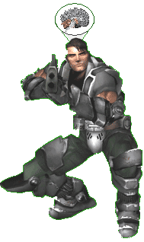
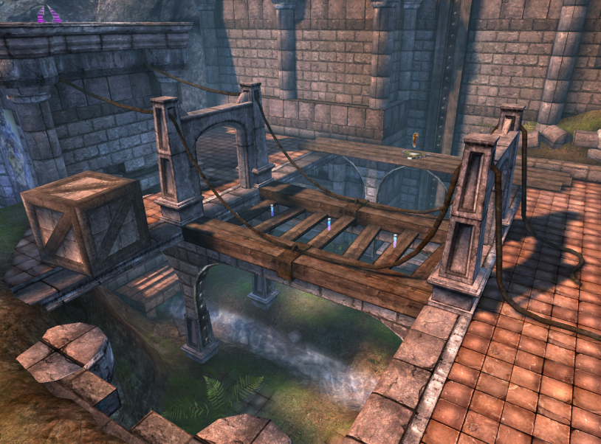
Big Picture
Memory (S)
Environment state (E)
Perception (P)
Action (A)
1. Part of environment state E is exported to the agent p(E) = P
2. Agent performs action-selection: f(P,S) -> AxS
3. Actions are carried out in the environment: a(A^{n},E) -> E
What if we dive deeper?

Slide 9
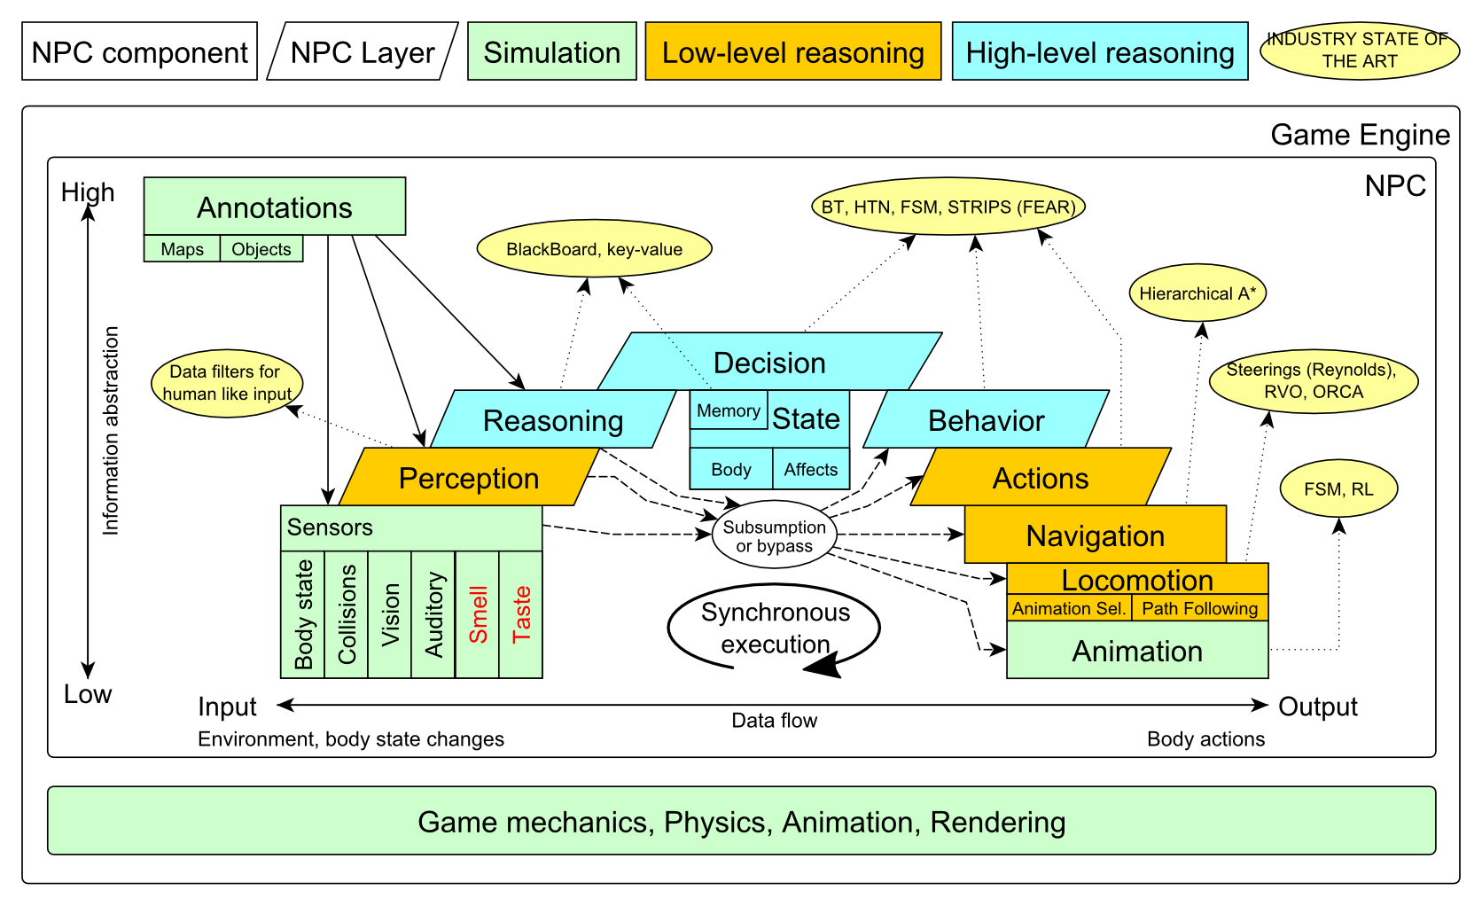
Big Picture

Slide 10
Big Picture Today

Slide 11
Today’s menu
Big Picture
How to see
Self, Player, Location, Rotation, Velocity
this.info, this.players
How to move
Move, Jump, Dodge
this.move
Tag! Game
Rules, Map
TagMap
How to think
Intelligence by design
Tag! Tournament Announcement

Slide 12
How to see? Sensors – Body state, Vision
IWorldObjects
Self, Player, Item, NavPoint, …
this.world.getSingle(Self.class)
this.world.getAll(Player.class)
this.world.getAll(Item.class)
this.world.getAll(NavPoint.class)
Agent modules
AgentInfo ~ this.info
Players ~ this.players
Items ~ this.items
NavPoints ~ this.navPoints
Location, Rotation, Velocity (explained later on)

Slide 13
How to see? Sensors – Body state, Vision
IWorldObjects
Self, Player, Item, NavPoint, …
All objects have unique UnrealId
Each unique id has single UnrealId instance
Each unique object has single instance
Agent modules are respecting this, no sneaky clone()s
What does it mean for Collections?
=> can be used in Set<UnrealId>, Set<Player>
=> can be used as key in Map<UnrealId, ?> , Map<Player, ?> without performance hit

Slide 14
How to see? Sensors – Body state, Vision
IWorldObjects
Self, Player, Item, NavPoint, …
All objects have unique UnrealId
Each unique id has single UnrealId instance
Each unique object has single instance
Agent modules are respecting this, no sneaky clone()s
What does it mean for object updates?
=> once obtained instances are auto-updated
=> there is no history

Slide 15
How to see? Sensors – Body state, Vision
IWorldObjects ~ low-level API
this.world.getSingle(Self.class)
Info about your bot
this.world.getAll(Player.class)
Returns Map<UnrealId, Player>
All players encountered during the session
this.world.getAllVisible(Player.class)
Returns Map<UnrealId, Player>
All players currently visible (in bot’s FOV)
this.world.getAll/Visible(Item.class)
this.world.getAll/Visible(NavPoint.class)
…

Slide 16
How to see? Sensors – Body state, Vision
Agent modules ~ low-level API façades
AgentInfo ~ this.info ~ Self
Players ~ this.players ~ Player(s)
Items ~ this.items ~ Item(s)
NavPoints ~ this.navPoints ~ NavPoint(s)
Advantages:
List of methods with JavaDoc
=> Easier to way to explore Pogamut API
Comprehensibly named methods
=> Easier to read & understand the code

Slide 17
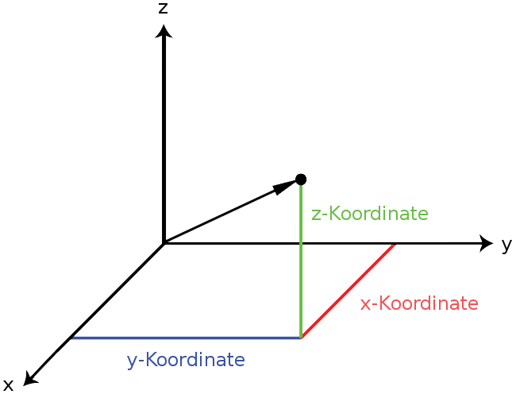
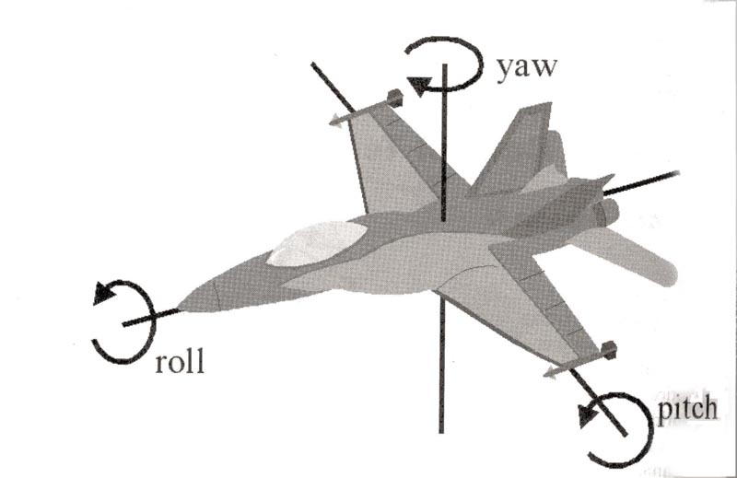
How to see? Sensors – Body state, Vision
Location
X, Y, Z (world space)
can be used as “vector”
add(), sub(), scale(), getDistance(), dot(), cross()
rotateXY/XZ/YZ()
Rotation
Pitch (XZ), Yaw (XY), Roll (YZ)
Velocity
X, Y, Z vector
Length is speed in UT units (1UT ~ 1cm)
All objects are immutables
=> Can be used in Set, Map

Slide 18
Today’s menu
Big Picture
How to see
Self, Player, Location, Rotation, Velocity
this.info, this.players
How to move
Move, Jump, Dodge
this.move
Tag! Game
Rules, Map
TagMap
How to think
Intelligence by design
Tag! Tournament Announcement

Slide 19
How to move? Actions
CommandMessages
Move, Jump, Dodge
this.act.act(new Move()…)
this.act.act(new Jump()…)
this.act.act(new Dodge()…)
Agent module
AdvancedLocomotion ~ this.move

Slide 20
How to move? Actions
CommandMessages ~ low-level API
Move
You can specify 1 location in advance
You can specify focus (where to look while moving), i.e., can be used for strafing
Jump
Can be used for double-jumps as well
Dodge
Can be used for quick direct jump to arbitrary location

Slide 21
How to move? Actions
Agent modules ~ low-level API façade
AdvancedLocomotion ~ this.move
All commands wrapped into methods
move.moveTo(), move.strafeTo(), move.jump(), …
Some simple algebra wrapped as well
move.dodgeLeft(), move.dodgeRight(), …

Slide 22
Today’s menu
Big Picture
How to see
Self, Player, Location, Rotation, Velocity
this.info, this.players
How to move
Move, Jump, Dodge
this.move
Tag! Game
Rules, Map
TagMap
How to think
Intelligence by design
Tag! Tournament Announcement

Slide 23
Tag! Game Children play
Custom “game-mode” for UT2004
Two roles:
Seeker (having “it”)
Runner or Prey
Seeker has to chase runners to pass „it“
After passing “it” the former seeker is immune to the new seeker
this.tag agent module
Custom map: DM-TagMap
Simple rectangle map, no obstacles
procedurally decsribed by TagMap static methods

Slide 24
Today’s menu
Big Picture
How to see
Self, Player, Location, Rotation, Velocity
this.info, this.players
How to move
Move, Jump, Dodge
this.move
Tag! Game
Rules, Map
TagMap
How to think
Intelligence by design
Tag! Tournament Announcement

Slide 25
How to think? Intelligence by design
Memory (S)
Environment state (E)
Perception (P)
Action (A)
1. Part of environment state E is exported to the agent p(E) = P
2. Agent performs action-selection: f(P,S) -> AxS
3. Actions are carried out in the environment: a(A^{n},E) -> E
Notes:
Always remember, that it is just a function you’re encoding. Each logic() cycle, you have to check in what state the environment and your body is to be able to give appropriate response.

Slide 26
How to think? Intelligence by design
Behavior Oriented Design
by Joanna J. Bryson (UK)
http://www.cs.bath.ac.uk/~jjb/web/bod.html
Specify top-level decision
Name the behaviors that the bot should do
Identify the list of sensors that is required to perform the behavior
Identify the priorities of behaviors
Identify behavior switching conditions
Recursion on respective behaviors until primitive actions reached

Slide 27
Today’s menu
Big Picture
How to see
Self, Player, Location, Rotation, Velocity
this.info, this.players
How to move
Move, Jump, Dodge
this.move
Tag! Game
Rules, Map
TagMap
How to think
Intelligence by design
Tag! Tournament Announcement

Slide 28
Tag! Tournament Chance to score extra points!
4 bots
1 Seeker, 3 Runners (1 of them will be immune…)
Random groups
Tournament will be held next week, only bots submitted until Saturday 15.3.2014, 9:00 will participate
No shooting allowed, no bot speed reconfigurations allowed
The best 6 bots from Tag! 2014 will participate in the tournament
You will have a chance to test your bots against them in advance

Slide 29
Assignment 3
Download the TagBot project template
Copy map/DM-TagMap.ut2 into UT2004/Maps folder
Alter UT2004/System/startGamebotsDMServer.bat replacing DM-TrainingDay with DM-TagMap
Implement both TagBot roles
Seeker ~ 5 points
Runner ~ 5 points
Implementations having one role only won’t be accepted (~ 0 points)

Slide 30
Assignment 3
Note that there are two “main” Java files in the project
TagBot
Bot template you have to finish
DO NOT ALTER ITS main METHOD!
TagGame
Class that starts the match between 4 your bots
Use this to test your bot

Slide 31
Assignment 3 Cheat sheet – Strategy – Catcher / Chaser
Your bot should recognize 3 stages of chasing
Early-stage
You are really far from your target
You have to quickly shorten this distance
Use rough double-dodges
Mid-stage
You are trying to corner your target
Be careful what commands you’re issuing, you probably want to avoid “straight” running to your target
Final-stage
You are near your target
You must take chances by doing final dodge-tag
You might want to distinguish between “corner”, “side wall” and “open space” situations here

Slide 32
Assignment 3 Cheat sheet – Strategy – Catcher / Chaser
Be sure not to pursue single target for a long time …
If you are unable to get from early->mid stage for a long time
If you are unable to get from mid->final stage for a long time
If your target manages to escape you and you switch from final->mid stage again

Slide 33
Assignment 3 Cheat sheet – Strategy – Catcher / Chaser
Be sure to be aware who got tagged … and not only by you!
If someone got tagged, there is a good chance you can tag him as well
You can even try to count how much time it was needed to tag someone to be aware of the “skill” of your opponents

Slide 34
Assignment 3 Cheat sheet – Movement – Catcher / Chaser
move.strafeTo(chasingLocation, escapeePlayer)
You should fix your focus to your prey while chasing
Can be also used to “look around” during the chase, but that requires timing and won’t probably work well
move.dodge(chasingDirectionVector, false/true)
If your prey is near, you can try to quick dodge to it
This will even work well during early stage of chase to quickly shorten the distance between you and your prey
Be careful though as you might actually worsen your situation during final-stage of tagging as you can “miss dodge” your target
False/True switches between Single/Double dodge modes

Slide 35
Assignment 3 Cheat sheet – Strategy – Runner / Escapee / Prey
Your bot should try not to get cornered
Your escape strategies typically distinguishes between 3 kinds of situations
Corner
You are in the corner
Try quick successive double dodges or double jumps
Then try to run for open-space position
Side-wall
Depending on the position of your chaser you should again
Try quick successive double dodges or double jumps
Then try to run for open-space position Open space
Open-space
You have a lot of space around you
You should try to run in circles, but keep an eye on your chaser … you always have to decide which kind of circle-run you want to perform (clockwise / counterclockwise) preferably switching between those two as required by the situation

Slide 36
Assignment 3 Cheat sheet - Movement – Runner / Escapee / Prey
move.strafeTo(escapeLocation, chaserPlayer)
Always use strafing and focus on the chaser to be sure to have up-to-date info about its position.
Suitable for circle-runs
move.dodge(escapeDirectionVector, true)
If in peril, try to perform double-dodge
move.doubleJump()
… or double jump

Slide 37
Assignment 3 Extra Tournament Files
Check the folder TagBot/tournament
There are batch files to execute tournament matches
match-best-2014.bat
Performs match between the first 4 bots of the Tag! 2014
match-123.bat
Performs match between your bot and 1st, 2nd and 3rd bot of Tag! 2014
match-456.bat
Performs match between your bot and 4th, 5th and 6th bot of Tag! 2014

Slide 38
Assignment 3 Extra Tournament Files
WARNING! You have to edit batch files first, to supply correct UT2004_HOME directory
Alter the line
set UT2004_HOME=d:\Games\UT2004-Devel
To match your environment, e.g.
set UT2004_HOME=c:\UT2004

Slide 39
Assignment 3 Extra Tournament Files
WARNING! Execution of the batch file might override you bot/server ports within UT2004_HOME\System\GameBots2004.ini
You might bump into “connection refused” exceptions when trying to run your bot from TagGame of the template project
Just restore original values within the GameBots2004.ini file, and restart a dedicated server:
[GameBots2004.BotDeathMatch]
BotServerPort=3000
ControlServerPort=3001
ObservingServerPort=3002

Slide 40
Assignment 3 Extra Tournament Videos
Check the folder TagBot/tournament-videos
There are several videos that might inspire you for coding Seeker/Runner behaviors

Slide 41
Send us finished assignment
Via e-mail:
Subject
“Pogamut homework 2014 – Assignment X”
Replace ‘X’ with the assignment number and the subject has to be without quotes of course
…or face -2 score penalization
To
jakub.gemrot@gmail.com
Jakub Gemrot (Tuesday practice lessons)
Attachment
Completely zip-up your project(s) folder except ‘target’ directory and IDE specific files (or face -2 score penalization)
Body
Please send us information about how much time it took you to finish the assignment + any comments regarding your implementation struggle
Information won’t be abused/made public
In fact it helps to make the practice lessons better
Don’t forget to mention your full name!

Slide 42
Questions? I sense a soul in search of answers…
We do not own the patent of perfection (yet…)
In case of doubts about the assignment, tournament or hard problems, bugs don’t hesitate to contact us!
Jakub Gemrot (Tuesday practice lessons)
jakub.gemrot@gmail.com
Michal Bída (Monday practice lessons)
michal.bida@gmail.com

