Slide 1
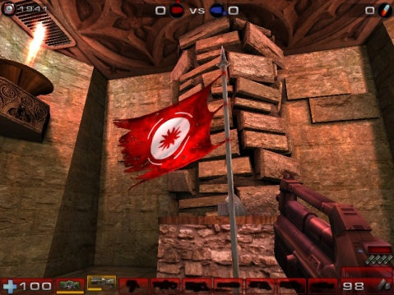
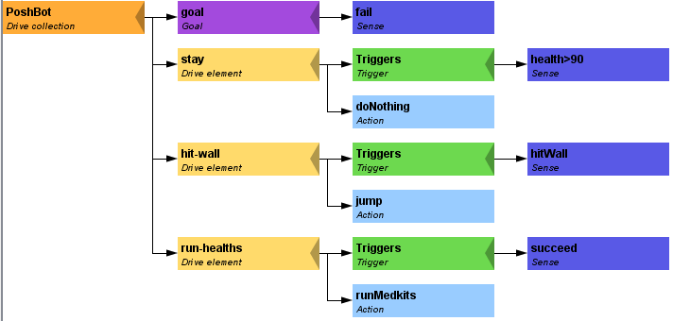
Pogamut 3
Faculty of Mathematics and Physics
Charles University in Prague
10th May 2016
UT2004 bots made easy!
Lecture 11 – Team Communication

Slide 2
Warm Up!
Fill the short test for this lessons
2 minutes limit
https://goo.gl/ZJoSxS
O vs. 0, i vs. l vs. 1
https://docs.google.com/forms/d/1Jd5C8-gS8JXvKPPT88AwbW6tWVqYvucZ29Nz3alDjSw/viewform

Slide 3
Today’s menu
Team Communication

Slide 4
Pogamut CTF support III Team communication
Use SendMessage command.
this.act.act(
new SendMessage()
.setTeamIndex(info.getTeam()).setText(“Help”)
);
Listen to team message with TeamChat event.
@EventListener(eventClass = TeamChat.class)
public void teamChat(TeamChat event) {
…
}
OLD AND SLOW
You must parse strings (blah…)
Messages goes through UT2004 tick -> unnecessary delay included

Slide 5
Pogamut CTF support IV UT2004TeamComm 1/4
Allows you to send Serializable Java objects between members of the team
Allows you to specify “subchannels”
You can easily listens to your messages as if they were IWorldEvent objects

Slide 6
Pogamut CTF support IV UT2004TeamComm 2/4
@EventListener(eventClass=TCMessage.class)
public void allMsg(TCMessage tcMessage) {
log.info("@EventListener(TCMessage)”);
}
Hook for listening to ALL messages TeamComm->Bot
Not advised to use, it’s pointless to parse the body of the message manually
@EventListener(eventClass=TCHello.class)
public void hello(TCHello hello) {
log.info("@EventListener(TCHello)”);
}
Hook for listening to TCHello messages TeamComm->Bot
Advised way, create separate message handler for every specific message
TCHello message is user-defined, you may create as many of them as you need

Slide 7
Pogamut CTF support IV UT2004TeamComm 3/4
public class TeamCommBot extends UT2004BotTCController<UT2004Bot>
<dependencies>
<dependency>
<groupId>cz.cuni.amis.pogamut.ut2004</groupId>
<artifactId>ut2004-team-comm</artifactId>
<version>3.7.1-SNAPSHOT</version>
</dependency>
</dependencies>
Java Example available at:
svn://artemis.ms.mff.cuni.cz/pogamut/trunk/project/Main/PogamutUT2004Examples/26-TeamCommBot

Slide 8
Pogamut CTF support IV UT2004TeamComm 4/4
public class TeamCommBotContext extends UT2004Context<UT2004Bot>
<dependencies>
<dependency>
<groupId>cz.cuni.amis.pogamut.ut2004</groupId>
<artifactId>sposh-ut2004</artifactId>
<version>3.7.1-SNAPSHOT</version>
</dependency>
</dependencies>
yaPOSH context contains support for TeamCommunication by default.

Slide 9
Assignment (or Homework)
Create CTF Team of Bots in yaPOSH
CTF Bot from previous lecture
+++
Team item picking

Slide 10
Send us finished assignment
Via e-mail:
Subject
“Pogamut homework 2015 – Assignment X”
Replace ‘X’ with the assignment number and the subject has to be without quotes of course
…or face -2 score penalization
To
jakub.gemrot@gmail.com
Jakub Gemrot (Tuesday practice lessons)
Attachment
Completely zip-up your project(s) folder except ‘target’ directory and IDE specific files (or face -2 score penalization)
Body
Please send us information about how much time it took you to finish the assignment + any comments regarding your implementation struggle
Information won’t be abused/made public
In fact it helps to make the practice lessons better
Don’t forget to mention your full name!

Slide 11
Questions? I sense a soul in search of answers…
We do not own the patent of perfection (yet…)
In case of doubts about the assignment, tournament or hard problems, bugs don’t hesitate to contact us!
Jakub Gemrot (Tuesday practice lessons)
jakub.gemrot@gmail.com

