Slide 1
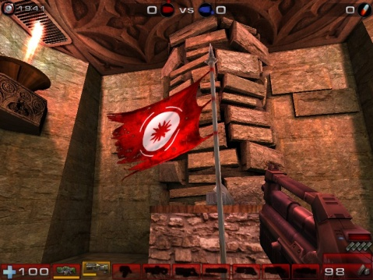
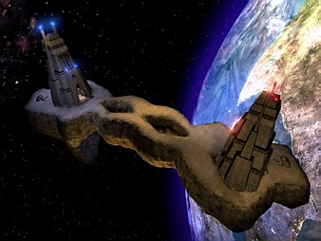
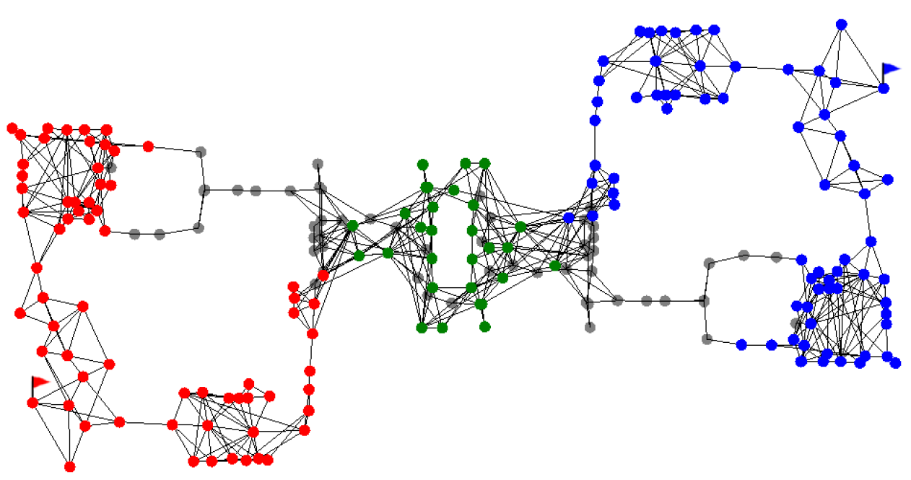
Pogamut 3
Faculty of Mathematics and Physics
Charles University in Prague
16th May 2016
UT2004 bots made easy!
Lecture 12 – Paths & Roles

Slide 2
Warm Up!
Fill the short test for this lessons
5 minutes limit
https://goo.gl/tpMMvg
O vs. 0, i vs. l vs. 1
https://docs.google.com/forms/d/1qGGnVitvTzlJHG_moCTGrM2m3ErFkQxgd2u4pYiBSGY/viewform

Slide 3
Today’s menu
Map Division
Roles in CTF team
Finding different paths within the environment

Slide 4
Map Division CTF Map
Red base <-> Mid ground <-> Blue base

Slide 5
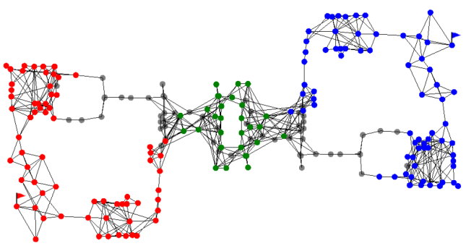
Map Division CTF Map
Red base <-> Mid ground <-> Blue base
Shorter path to red base:
0 <= |Path(RFlag, Point)| / |Path(Point, BFlag)| < 1
Shorter path to blue base:
0 <= |Path(BFlag, Point)| / |Path(Point, RFlag)| < 1
Mid ground:
C <= |Path(RFlag, Point)| / |Path(Point, BFlag)| < 1
C <= |Path(BFlag, Point)| / |Path(Point, RFlag)| < 1

Slide 6
Map Division Roles in CTF team
My base => defender
Mid ground => roamer
Enemy Base => attacker

Slide 7
Map Division Roles in CTF team
How to synchronize intentions within team?
N (cooperating) bots want to perform I; I is m-exclusive
Broadcast score of bot achieving intention I
m-highest (or m-lowest) wins
Resend to anyone who wants to join in the middle of execution
How to decide on strategy?
“Group brain” => have a leader that instructs others
Establish leader via previous scheme

Slide 8
Map Division Different paths
There are multiple paths between bases
There is only one shortest path
How to find the others?

Slide 9
Map Division Different paths
Finding k-shortest paths ~ O(m +n log n +kn)
David Eppstein
G(vertices, edges), |vertices| = n, |edges|= m
Problem: too many similar paths ~ k needs to be high
Problem: Having k paths, find really different ones
But we already have Floyd-Warshall matrix
=> We can construct “Different path” heuristic

Slide 10
Map Division Different paths
Having FW matrix for G(V, E), |V| = n, having M paths, find next “different” path?
Different == Cost of being too close to some path
PathsDistance(point):
Min( { Min( { | path(point -> path-i-point-k) | }_{k} ) } _{i} )
Can be used for penalization of points during next A*
Min( { | path(point -> path-i-point-k) | }_{k} )
Can be precomputed time O(n²)
PathsDistance can be incrementally updated
Time cost of M+1 different paths O(M.n²) + (M+1).A*
Typically works in O(n²)
Extra space cost O(n)
For storing PathsDistance(point)

Slide 11
Assignment (or Homework)
Create CTF Team of Bots in yaPOSH
CTF Bot from previous two lectures
+++
Include “Guard own flag holder” behavior
5 points
Include “Team hunt enemy flag holder” behavior
5 points
Include “Run cover path” behavior
5 points
Include “Run non-shortest path” behavior
10 points
Come up with other CTF-team behavior
10 points
You may form teams of two people for creating this!

Slide 12
Send us finished assignment
Via e-mail:
Subject
“Pogamut homework 2016 – Assignment X”
Replace ‘X’ with the assignment number and the subject has to be without quotes of course
…or face -2 score penalization
To
jakub.gemrot@gmail.com
Jakub Gemrot (Tuesday practice lessons)
Attachment
Completely zip-up your project(s) folder except ‘target’ directory and IDE specific files (or face -2 score penalization)
Body
Please send us information about how much time it took you to finish the assignment + any comments regarding your implementation struggle
Information won’t be abused/made public
In fact it helps to make the practice lessons better
Don’t forget to mention your full name!

Slide 13
Questions? I sense a soul in search of answers…
In case of doubts about the assignment, tournament or hard problems, bugs don’t hesitate to contact us!
Jakub Gemrot (Tuesday practice lessons)
jakub.gemrot@gmail.com

