Slide 1
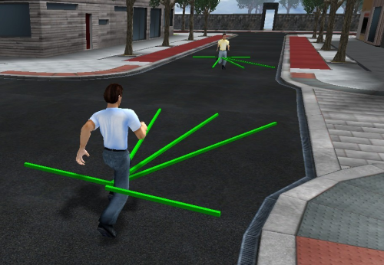
Pogamut 3
Faculty of Mathematics and Physics
Charles University in Prague
22nd March 2016
UT2004 & UE2 bots made easy!
Lecture 4 – Steering Behaviors

Slide 2
Setup
Start downloading SteeringGame 2.0 ZIP
http://pogamut.cuni.cz/pogamut_files/lectures/misc/SteeringGame2.0.zip
O vs. 0, i vs. l, 1 vs. l
Or just get it from http://bit.ly/pogamut3labs
Unzip it into D:\

Slide 3
Warm Up!
Fill the short test for this lessons
10 minutes limit
https://goo.gl/sPUOmU
O vs. 0, i vs. l, 1 vs. l
Permanent link
https://docs.google.com/forms/d/1xl7H9gtsjEb2zkwE68MFtDjtW73W_6-LWEUBcvn9KHE/viewform

Slide 4
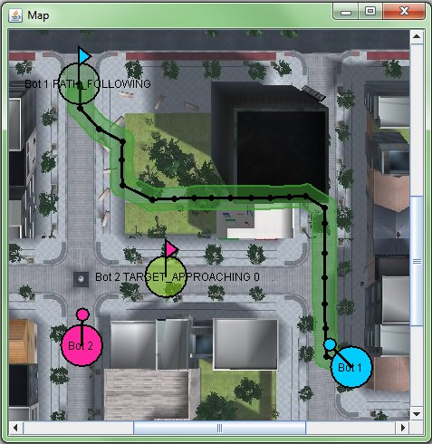
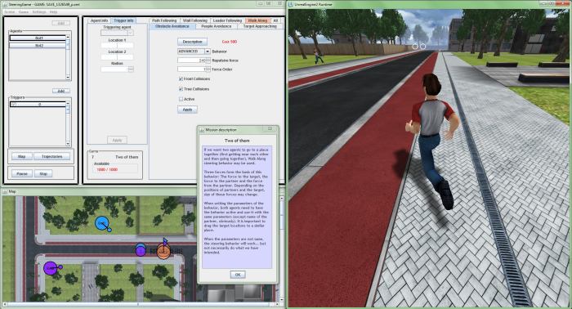
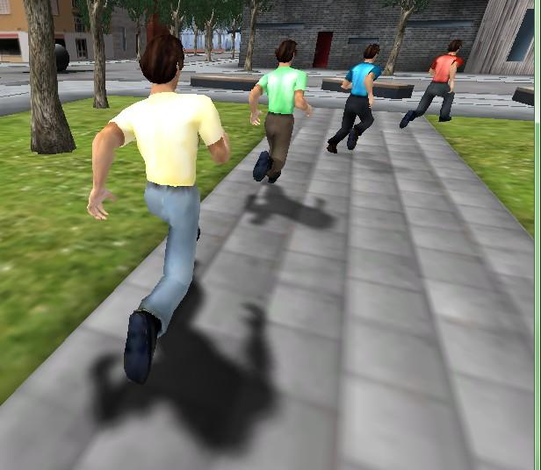
Today‘s menu
Steerings
Steering Game
Steering Assignment

Slide 5
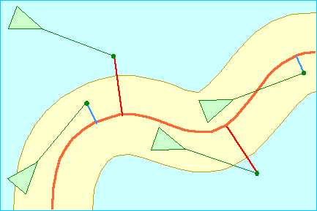
What is Steering?
… Google: reynolds steering ☺
Craig Reynolds
http://www.red3d.com/cwr/steer/
Notes:
Principy, náčrtky, hlavní procedury a funkce.

Slide 6
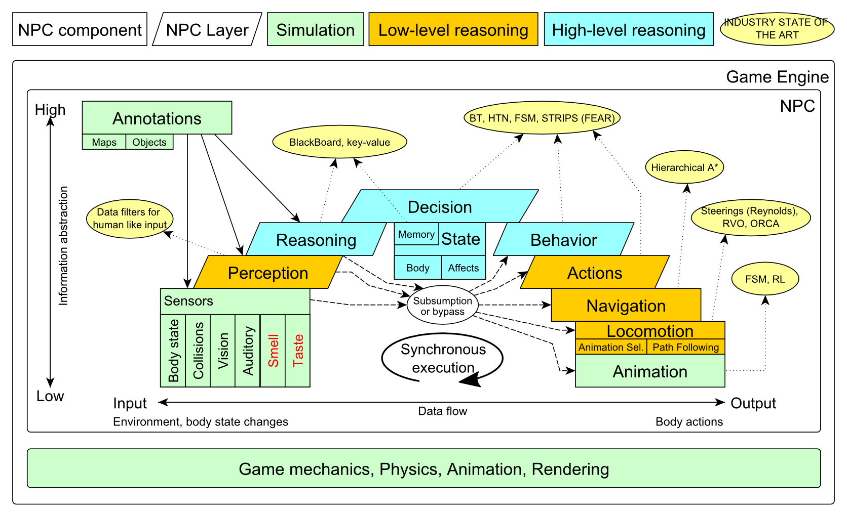
Big Picture Today
Notes:
So where are we today?
(click)
Notice, that there is no NPC layer involved … just sensors and then the navigation component.

Slide 7
Steering Schema
Steering Manager
Previous Velocity
Previous Velocity
Target Approaching
Obstacle Avoidance
…
Next Velocity
Notes:
Principy, náčrtky, hlavní procedury a funkce.

Slide 8
Steering Schema
$$\frac{w_{0}∙v_{t−1}+ \sum_{i ∈I}{\left(w_{i}∙s_{i}\right)}}{w_{0}+\sum_{i ∈I}{w_{i}}}$$
(𝑤_0∙𝑣_(𝑡−1)+ ∑_(𝑖 ∈𝐼)▒(𝑤_𝑖∙𝑠_𝑖 ) )/(𝑤_0+∑_(𝑖 ∈𝐼)▒𝑤_𝑖 )
Previous Velocity $v_{t}$
Previous Velocity 𝑣_𝑡
Target Approaching $s_{1}$
Target Approaching 𝑠_1
Obstacle Avoidance $s_{2}$
Obstacle Avoidance 𝑠_2
…
w$eight w_{0}$
w$eight w_{1}$
Next Velocity $v_{t+1}$
w$eight w_{2}$
$$I= \left\{i=1, …, n | s_{i} ≠0\right\}$$
Notes:
Principy, náčrtky, hlavní procedury a funkce.

Slide 9
Steering Game
Steering Tool & Steering Game website
http://goo.gl/NQsDrG
Contains explanation how to work with the game!
SteeringGame 2.0 Installer
http://goo.gl/JE6uh0
SteeringGame 2.0 ZIP
http://goo.gl/gm02RT
Files used in this lesson : WorkshopScenes
http://goo.gl/PlIlzE

Slide 10
Steering Game Starting the game
You need to run 3 files in this order
Server. You will find it in the directory with the installed SteeringGame:
d:\SteeringGame2.0\SteeringServer.bat
or
d:\SteeringGame2.0\UnrealEngine2RuntimeDemo\System\startEmohawkServer.bat
If the window about allowing communication of UCC appears, confirm Allow access.
3D virtual environment (UE2Runtime). It will be in the same directory:
d:\SteeringGame2.0\SteeringClient.bat
or
d:\SteeringGame2.0\UnrealEngine2RuntimeDemo\System\startUE2Runtime.bat
Wait 10s and then confirm OK. When the environments is loaded, press Esc.
The SteeringGame. Run the file:
d:\SteeringGame2.0\SteeringGame.exe
Loading may take some time (about 1 min).

Slide 11
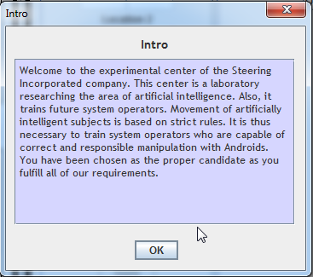
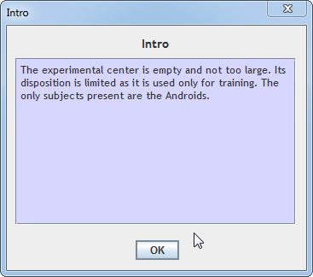
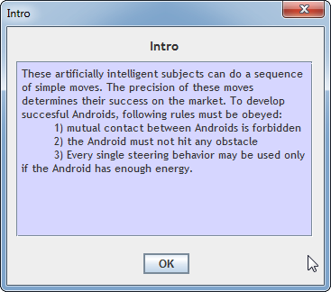
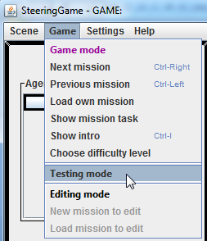
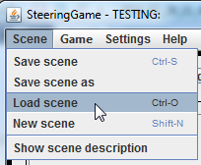
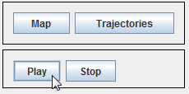
Steering Game How to load “practice” file
Once you have Steering Game up-and-running
Ok, ok, ok… Continue with training mission
Then switch to TESTING MODE -------->
Load first scene file
OA_front_a_p.xml
Click “play” and look for the guy in UE2
Be patient!
…

Slide 12
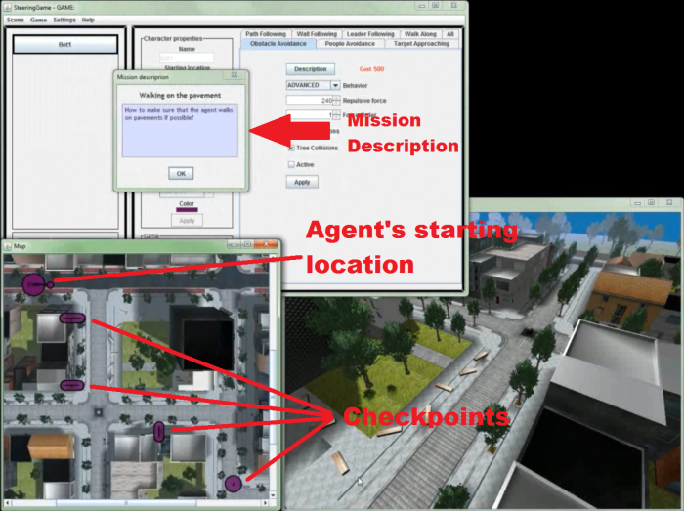
Steering Game How it looks like
Notes:
Principy, Tutoriálové mise – prvních pár.
Vysvětlit domácí úkol.

Slide 13
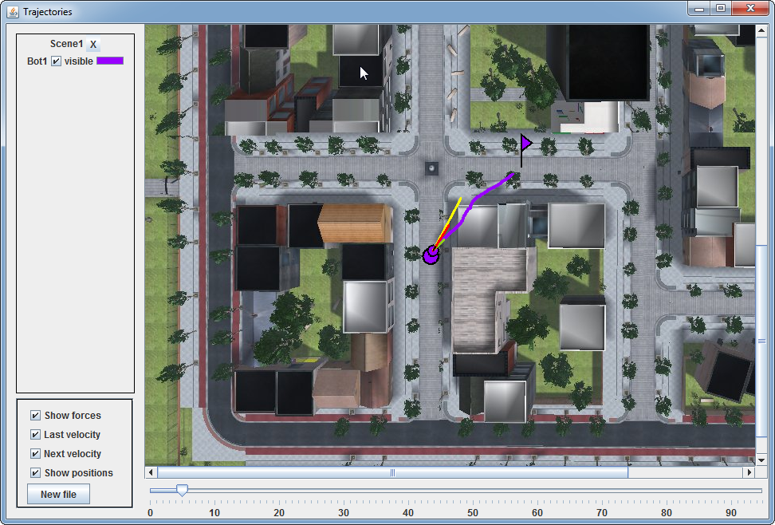
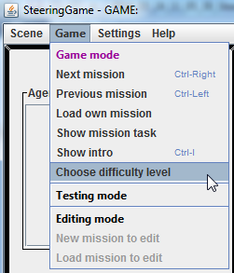
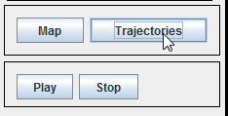
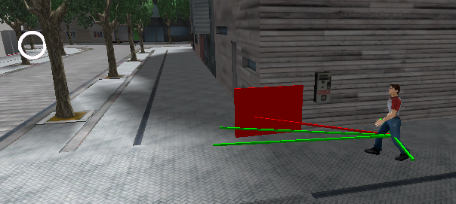
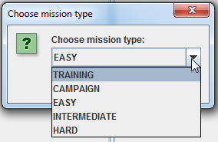
Steering Game Trajectories
Choosing difficulty level
and iterating through missions.
Once you “play and stop” the steering, you can open “Trajectories” of bots and checkout step by step, what result steering force bots had.
When you succeed in the mission, the “Trajectories” are still holding the last run!
Print-screen them as proofs!
Notes:
Principy, Tutoriálové mise – prvních pár.
Vysvětlit domácí úkol.

Slide 14
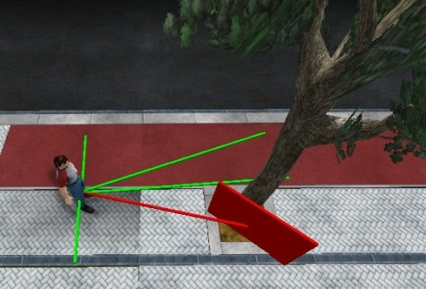
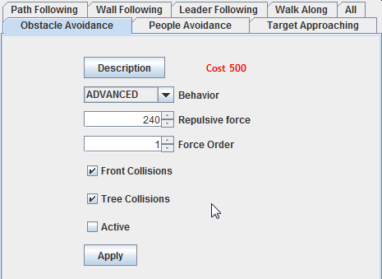
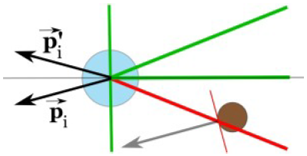
Steering Behaviors 1/3
Obstacle Avoidance
Front Collision – Why and how to solve it?
OA_front_a_p.xml
Tree Collisions – Why and how to solve it?
OA_tree_a_p.xml
Notes:
Vše popsáno v Bc. práci Markéty Popelové
-- ….\NAIL068-UmeleBytosti\Lectures\AB2015-Lectures\Lecture-04-Steerings\
Front Collision => check Front Collision
K řešení čelních kolizí používá steering s parametrem Front Collisions rotační vektor ~r,
který je kolmý na vektor rychlosti agenta a míří doprava či doleva
podle toho, zda jde agent k překážce spíše zleva či zprava. Pokud jde agent přímo
kolmo na překážku, směr (levý/pravý) se zvolí náhodně. Velikost vektoru ~r se
nastaví jako polovina velikosti vektoru ~pi příslušný danému paprsku. K vektoru
~pi se pak přičte vektor ~r. Výsledný vektor se použije jako vektor příslušný dan
ému paprsku. Pomocí této rotační síly se agent před překážkou stočí a plynule
pokračuje podél ní.
Tree Collision => generate “symmetric” force instead
Problém je, že ~pi míří na druhou stranu, než kudy by se měl agent překážce vyhnout.
Místo něj se tedy použije vektor ~p0i, který je s ním osově souměrný podle osy
dané vektorem rychlosti agenta, viz Obrázek 3.5.

Slide 15
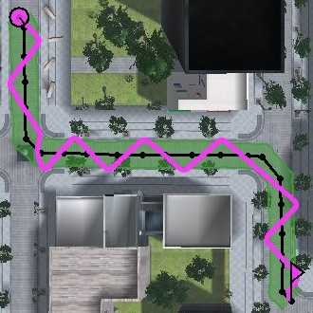
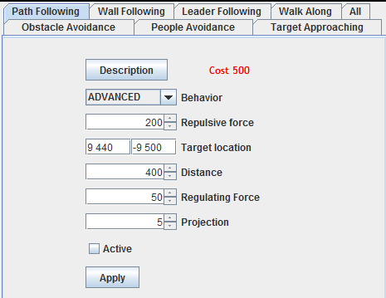
Steering Behaviors 2/3
Path Following
How to improve Path following
Smoother trajectory, more natural in curves)?
What will be the impact of longer Projection
and Regulation Force and why?
Regulation Force
Find the ideal value.
PF_regulation_p.xml
Notes:
Regulation force => maximální síla, která se generuje, aby se stočil k dalšímu bodu

Slide 16
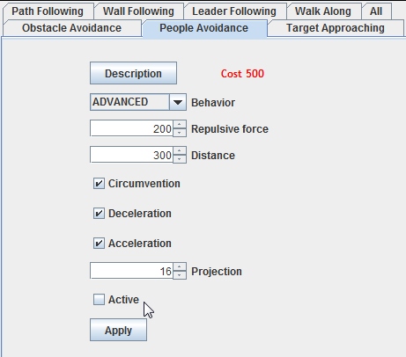
Steering Behaviors 3/3
People Avoidance
Oncoming – How big has to be the steering force to prevent the collision? How to solve it better?
Crossing – What will happen? Why? How to solve it?

Slide 17
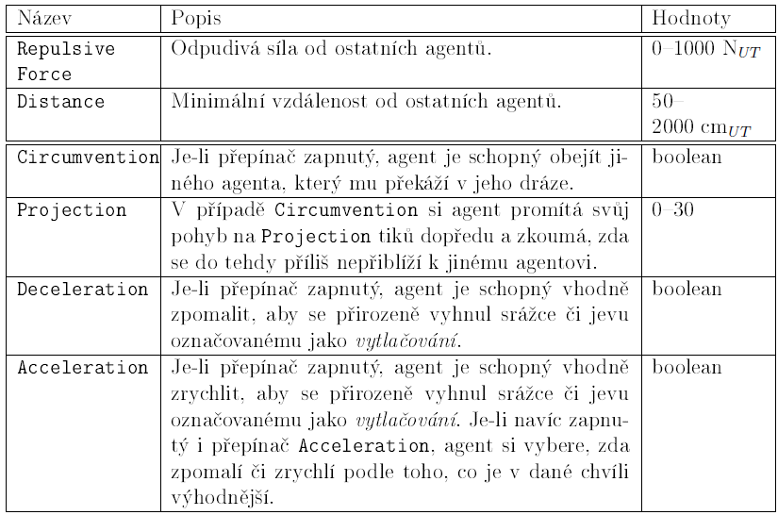
Steering Behaviors 3/3

Slide 18
Assignment 4 SteeringGame
Download and install Steering Game
SteeringGame 2.0 installer
http://goo.gl/JE6uh0
Learn how to work with the game
http://goo.gl/NQsDrG
Compulsory
Solve at least four EASY levels from the Steering Game
~ 1 point each
Solve two INTERMEDIATE levels from the Steering Game
~ 2 points each
8 points
Bonus (up-to 6 points)
Solve three HARD levels from the Steering Game
~ 2 points each
Up to 6 points

Slide 19
Assignment 4 SteeringGame
After finishing the level, save trajectories of your solution AND make a screenshot with your trajectory!
Name files as “Level-Difficulty-X” (without quotes of course), where X is the actual number of the level from chosen difficulty.

Slide 20
Send us finished assignment
Via e-mail:
Subject
“Pogamut homework 2016 – Assignment X”
Replace ‘X’ with the assignment number and the subject has to be without quotes of course
…or face -2 score penalization
To
jakub.gemrot@gmail.com
Jakub Gemrot (Tuesday practice lessons)
Attachment
Completely zip-up your folders containing level solution, level solutions are named “Level-DIFFICULTY-X” where DIFFICULTY is level’s difficulty and X is the actual number of the level of the chosen difficulty (or face -2 score penalization)
Body
Please send us information about how much time it took you to finish the assignment + any comments regarding your implementation struggle
Information won’t be abused/made public
In fact it helps to make the practice lessons better
Don’t forget to mention your full name!

Slide 21
Questions? I sense a soul in search of answers…
We do not own the patent of perfection (yet…)
In case of doubts about the assignment, tournament or hard problems, bugs don’t hesitate to contact us!
Jakub Gemrot (Tuesday practice lessons)
jakub.gemrot@gmail.com

