Slide 1
Tag! Tournament in Pogamut 3
University of West Bohemia, Pilsen
23rd February 2015
UT2004 bots made easy!
Practical lesson
Tag! Tournament

Slide 2
Workshop website On Pogamut devel wiki…
Visit workshop website
http://pogamut.cuni.cz/pogamut-devel/doku.php?id=lectures:pilsen_pogamut_2014-15_summer_semester
1) Go to http://pogamut.cuni.cz
2) Find a link to devel wiki (http://pogamut.cuni.cz/pogamut-devel)
3) In main menu Click Lectures
4) Find and click a link to this years Pilsen workshop website and …
Assigment Tag! Bot
Start downloading the TagBot project template (~64MB) in advance … now ☺

Slide 3
Motivation >>> Why am I sitting here?
<<< We’re going to dive into PogamutUT2004 platform … technically.
>>> Great, just another proprietary library…
<<< Correct, but:
<<< 1) you have to deal with them everywhere,
<<< 2) platform is created around universal principles, you will learn what to look for in other game engines.
>>> Really… [skeptical face]
<<< We can only show you the door, you are the one who has to go through it… ;-)
Notes:
How many of you are asking yourself this question?
If you do, excellent! You should always be aware whether time you are or were spending is or was worthy.
If you do not, well I would opt for you should begin!
So… what is your answer to this meaning-of-life question?

Slide 4
Today’s menu
Big Picture
How to see
Self, Player, Location, Rotation, Velocity
this.info, this.players
How to move
Move, Jump, Dodge
this.move
Tag! Game
Rules, Map
TagMap
How to think
Intelligence by design
Tag! Tournament Announcement

Slide 5
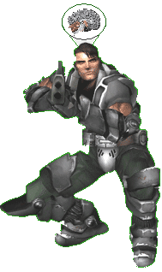
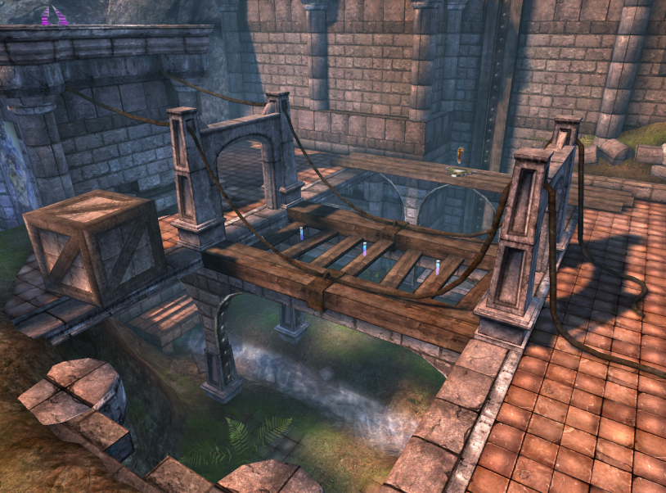
Big Picture
Memory (S)
Environment state (E)
Perception (P)
Action (A)
1. Part of environment state E is exported to the agent p(E) = P
2. Agent performs action-selection: f(P,S) -> AxS
3. Actions are carried out in the environment: a(A^{n},E) -> E
What if we dive deeper?

Slide 6
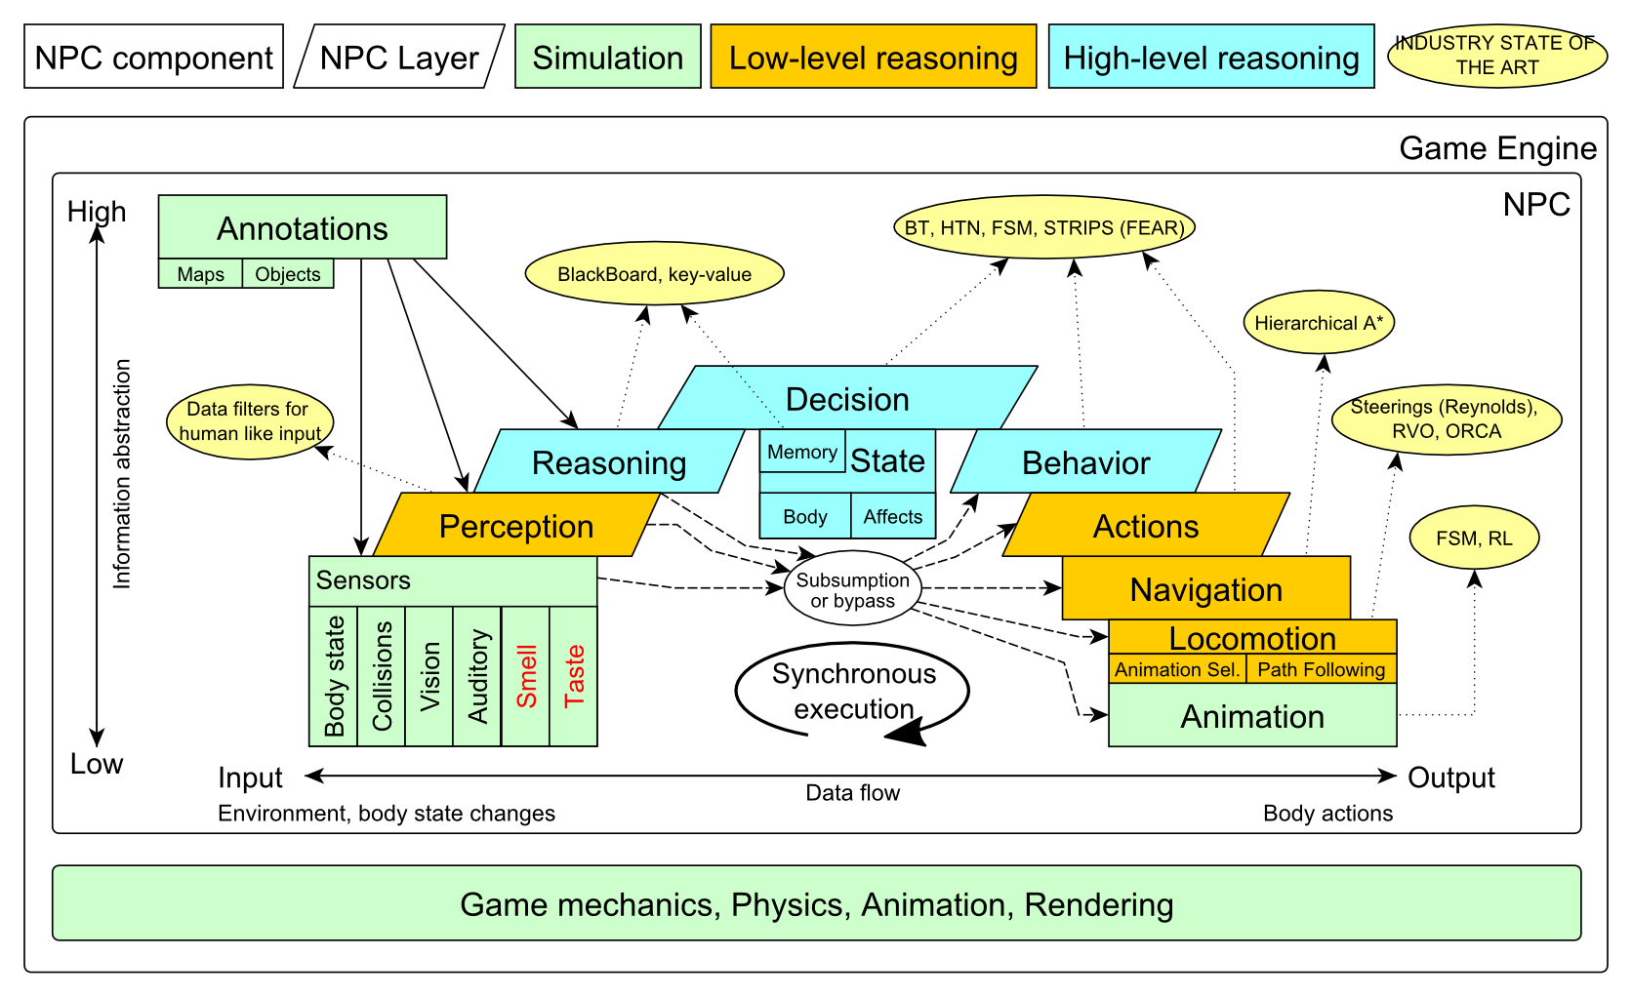
Big Picture

Slide 7
Big Picture Today

Slide 8
Today’s menu
Big Picture
How to see
Self, Player, Location, Rotation, Velocity
this.info, this.players
How to move
Move, Jump, Dodge
this.move
Tag! Game
Rules, Map
TagMap
How to think
Intelligence by design
Tag! Tournament Announcement

Slide 9
How to see? Sensors – Body state, Vision
IWorldObjects
Self, Player, Item, NavPoint, …
this.world.getSingle(Self.class)
this.world.getAll(Player.class)
this.world.getAll(Item.class)
this.world.getAll(NavPoint.class)
Agent modules
AgentInfo ~ this.info
Players ~ this.players
Items ~ this.items
NavPoints ~ this.navPoints
Location, Rotation, Velocity

Slide 10
How to see? Sensors – Body state, Vision
IWorldObjects
Self, Player, Item, NavPoint, …
All objects have unique UnrealId
Each unique id has single UnrealId instance
Each unique object has single instance
Agent modules are respecting this, no sneaky clone()s
What does it mean for Collections?
=> can be used in Set<UnrealId>, Set<Player>
=> can be used as key in Map<UnrealId, ?> , Map<Player, ?> without performance hit

Slide 11
How to see? Sensors – Body state, Vision
IWorldObjects
Self, Player, Item, NavPoint, …
All objects have unique UnrealId
Each unique id has single UnrealId instance
Each unique object has single instance
Agent modules are respecting this, no sneaky clone()s
What does it mean for object updates?
=> once obtained instances are auto-updated
=> there is no history

Slide 12
How to see? Sensors – Body state, Vision
IWorldObjects ~ low-level API
this.world.getSingle(Self.class)
Info about your bot
this.world.getAll(Player.class)
Returns Map<UnrealId, Player>
All players encountered during the session
this.world.getAllVisible(Player.class)
Returns Map<UnrealId, Player>
All players currently visible (in bot’s FOV)
this.world.getAll/Visible(Item.class)
this.world.getAll/Visible(NavPoint.class)
…

Slide 13
How to see? Sensors – Body state, Vision
Agent modules ~ low-level API façades
AgentInfo ~ this.info ~ Self
Players ~ this.players ~ Player(s)
Items ~ this.items ~ Item(s)
NavPoints ~ this.navPoints ~ NavPoint(s)
Advantages:
List of methods with JavaDoc
=> Easier to way to explore Pogamut API
Comprehensibly named methods
=> Easier to read & understand the code

Slide 14
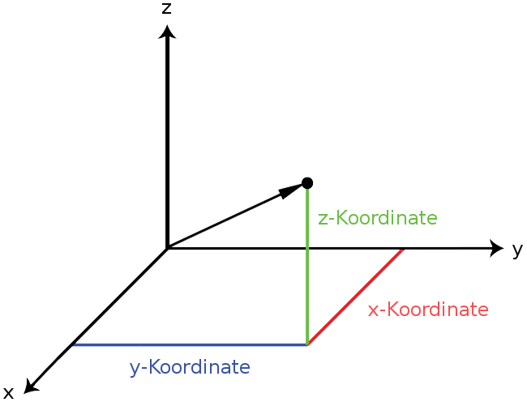
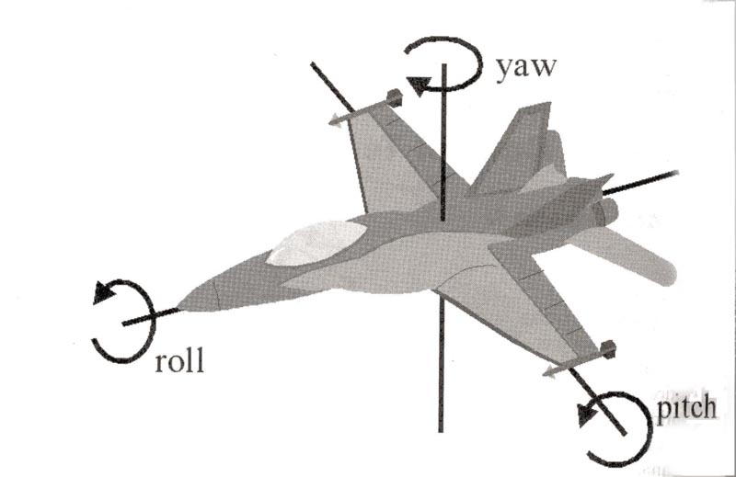
How to see? Sensors – Body state, Vision
Location
X, Y, Z
can be used as “vector”
add(), sub(), scale(), getDistance(), dot(), cross()
rotateXY/XZ/YZ()
Rotation
Pitch (XZ), Yaw (XY), Roll (YZ)
Velocity
X, Y, Z
All objects are immutables
=> Can be used in Set, Map

Slide 15
Today’s menu
Big Picture
How to see
Self, Player, Location, Rotation, Velocity
this.info, this.players
How to move
Move, Jump, Dodge
this.move
Tag! Game
Rules, Map
TagMap
How to think
Intelligence by design
Tag! Tournament Announcement

Slide 16
How to move? Actions
CommandMessages
Move, Jump, Dodge
this.act.act(new Move()…)
this.act.act(new Jump()…)
this.act.act(new Dodge()…)
Agent module
AdvancedLocomotion ~ this.move

Slide 17
How to move? Actions
CommandMessages ~ low-level API
Move
You can specify 1 location in advance
You can specify focus (where to look while moving), i.e., can be used for strafing
Jump
Can be used for double-jumps as well
Dodge
Can be used for quick direct jump to arbitrary location

Slide 18
How to move? Actions
Agent modules ~ low-level API façade
AdvancedLocomotion ~ this.move
All commands wrapped into methods
move.moveTo(), move.strafeTo(), move.jump(), …
Some simple algebra wrapped as well
move.dodgeLeft(), move.dodgeRight(), …

Slide 19
Today’s menu
Big Picture
How to see
Self, Player, Location, Rotation, Velocity
this.info, this.players
How to move
Move, Jump, Dodge
this.move
Tag! Game
Rules, Map
TagMap
How to think
Intelligence by design
Tag! Tournament Announcement

Slide 20
Tag! Game Children play
Custom “game-mode” for UT2004
Two roles:
Seeker (having “it”)
Runner or Prey
Seeker has to chase runners to pass „it“
After passing “it” the former seeker is immune to the new seeker
this.tag agent module
Custom map: DM-TagMap
Simple rectangle map, no obstacles
procedurally decsribed by TagMap static methods

Slide 21
Today’s menu
Big Picture
How to see
Self, Player, Location, Rotation, Velocity
this.info, this.players
How to move
Move, Jump, Dodge
this.move
Tag! Game
Rules, Map
TagMap
How to think
Intelligence by design
Tag! Tournament Announcement

Slide 22
How to think? Intelligence by design
Memory (S)
Environment state (E)
Perception (P)
Action (A)
1. Part of environment state E is exported to the agent p(E) = P
2. Agent performs action-selection: f(P,S) -> AxS
3. Actions are carried out in the environment: a(A^{n},E) -> E
Notes:
Always remember, that it is just a function you’re encoding. Each logic() cycle, you have to check in what state the environment and your body is to be able to give appropriate response.

Slide 23
How to think? Intelligence by design
Behavior Oriented Design
by Joanna J. Bryson (UK)
http://www.cs.bath.ac.uk/~jjb/web/bod.html
Specify top-level decision
Name the behaviors that the bot should do
Identify the list of sensors that is required to perform the behavior
Identify the priorities of behaviors
Identify behavior switching conditions
Recursion on respective behaviors until primitive actions reached

Slide 24
Today’s menu
Big Picture
How to see
Self, Player, Location, Rotation, Velocity
this.info, this.players
How to move
Move, Jump, Dodge
this.move
Tag! Game
Rules, Map
TagMap
How to think
Intelligence by design
Tag! Tournament Announcement

Slide 25
Tag! Tournament Chance to earn honor and glory!
4 bots
1 Seeker, 3 Runners (1 of them will be immune…)
Random groups
No shooting allowed, no bot speed reconfigurations allowed
Details will be announced
When, where, how…
The best N bots from previous Tag! Tournament will participate?
You will have a chance to test your bots against them in advance

Slide 26
Assignment Tag! Bot
Download the TagBot project template
Copy map/DM-TagMap.ut2 into UT2004/Maps folder
Alter UT2004/System/startGamebotsDMServer.bat replacing DM-TrainingDay with DM-TagMap
Implement both TagBot roles
Seeker
Runner
Implementations having one role only won’t be accepted for the tournament

Slide 27
Assignment Tag! Bot
Note that there are two “main” Java files in the project
TagBot
Bot template you have to finish
DO NOT ALTER ITS main METHOD!
TagGame
Class that starts the match between 4 your bots
Use this to test your bot

Slide 28
Assignment Tag! Bot Extra Tournament Files
Check the folder TagBot/tournament
There are batch files to execute tournament matches
match-best-2013.bat
Performs match between the first 4 bots of the Tag! 2013
match-123.bat
Performs match between your bot and 1st, 2nd and 3rd bot of Tag! 2013
match-456.bat
Performs match between your bot and 4th, 5th and 6th bot of Tag! 2013

Slide 29
Assignment Tag! Bot Extra Tournament Files
WARNING! You have to edit batch files first, to supply correct UT2004_HOME directory
Alter the line
set UT2004_HOME=d:\Games\UT2004-Devel
To match your environment, e.g.
set UT2004_HOME=c:\UT2004

Slide 30
Assignment Tag! Bot Extra Tournament Files
WARNING! Execution of the batch file might override you bot/server ports within UT2004_HOME\System\GameBots2004.ini
You might bump into “connection refused” exceptions when trying to run your bot from TagGame of the template project
Just restore original values within the GameBots2004.ini file, and restart a dedicated server:
[GameBots2004.BotDeathMatch]
BotServerPort=3000
ControlServerPort=3001
ObservingServerPort=3002

Slide 31
Assignment Tag! Bot Extra Tournament Videos
Check the folder TagBot/tournament-videos
There are several videos that might inspire you for coding Seeker/Runner behaviors

Slide 32
Send us finished assignment
Via e-mail:
Subject
“Pogamut Pilsen 2015 – Tag Bot”
Replace ‘X’ with the assignment number and the subject has to be without quotes of course
…or face -2 score penalization (I mean our wrath)
To
jakub.gemrot@gmail.com
Jakub Gemrot
Attachment
Completely zip-up your project(s) folder except ‘target’ directory and IDE specific files (or face -3 score penalization (even greater wrath))
Body
Please send us information about how much time it took you to finish the assignment + any comments regarding your implementation struggle
Information won’t be abused/made public
In fact it helps to make the practice lessons better
Don’t forget to mention your full name!

Slide 33
Questions? I sense a soul in search of answers…
We do not own the patent of perfection (yet…)
In case of doubts about the assignment, tournament or hard problems, bugs don’t hesitate to contact us!
Jakub Gemrot
jakub.gemrot@gmail.com
Michal Bída
michal.bida@gmail.com

